Slide 1
Emil Svanberg
The Office of Technology Commercialization

Slide 2

LTU Business AB (est 1983) is the largest
business development company in northern Scandinavia,
non-profit and fully owned by Luleå University of Technology

Slide 3

Our service offering
We offer services in Innovation management, Business development and Professional education.
In addition to being the Office for Tech Commercialization for Luleå University of Technology, we serve private and public sector clients across Europe.
Example clients: RISE, EIT RawMaterials, Skellefteå Kommun

Slide 4

THE LTU INNOVATION ECOSYSTEM
1. Ideas, results inventions
from students, staff and researchers
2. Innovation Support
3. Business
Incubation
4. Growth and expansion
LTU Business AB
(SME Services)
ABI
ESA-BIC
Go Business
Luleå University of Technology
LTU Business AB
Science Parks
(offices etc)
Lunova AB

Slide 5
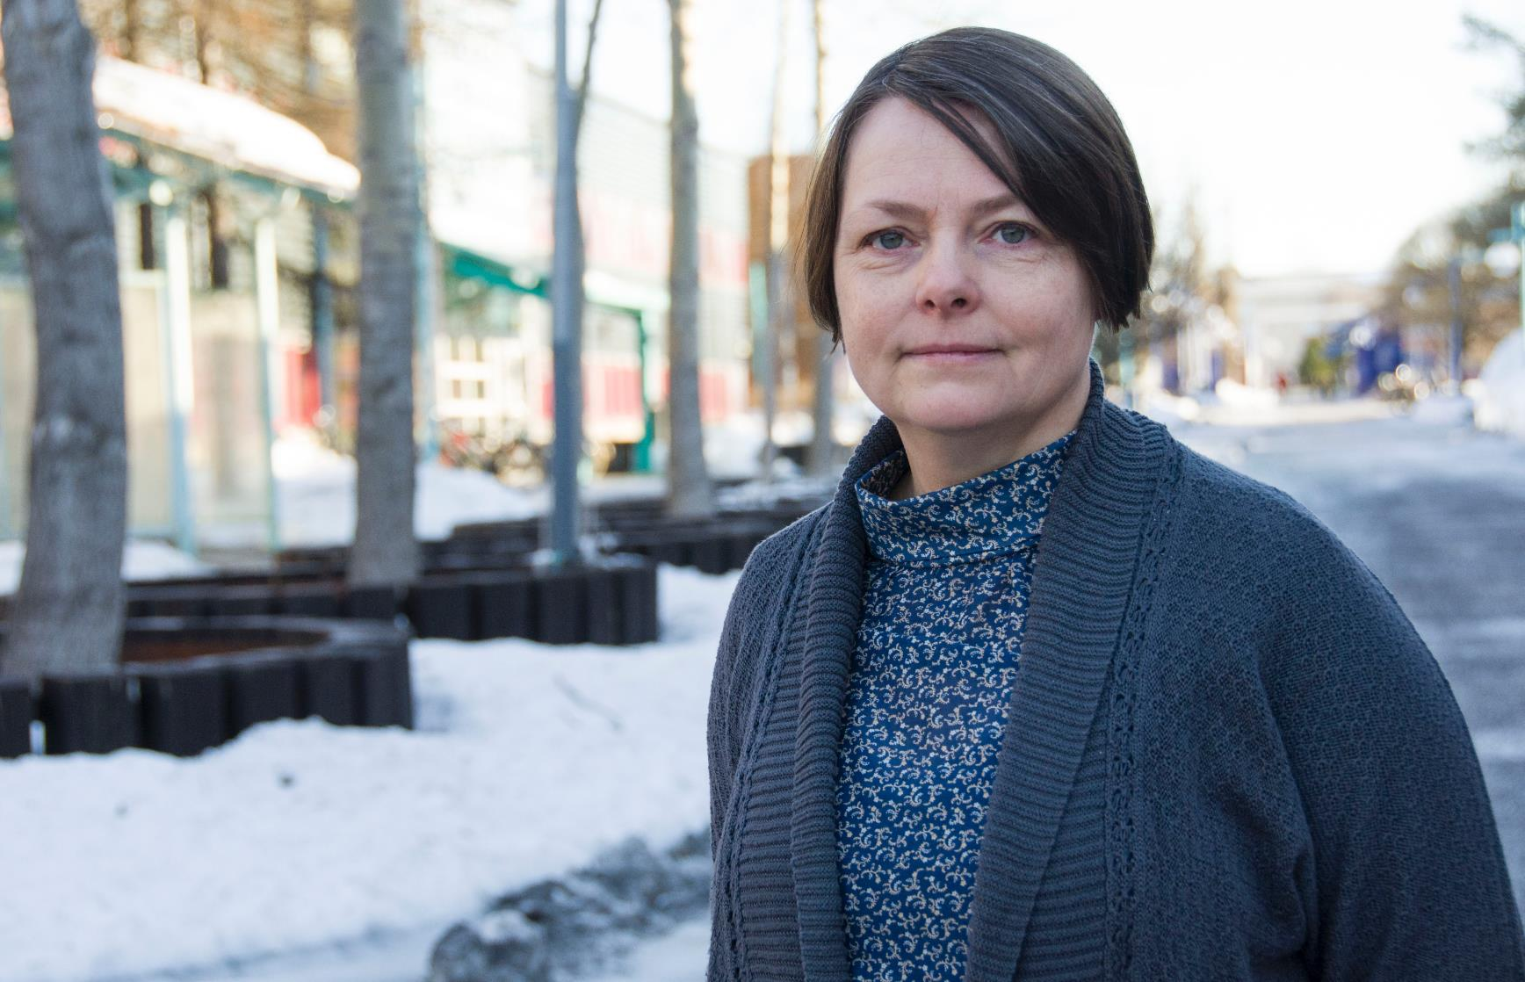
MedSense
Researcher Kerstin Ramser develops a new tool for cancer diagnostics with big potential.
Result:
LTU Business develops a patent and IPR-strategy.

Slide 6
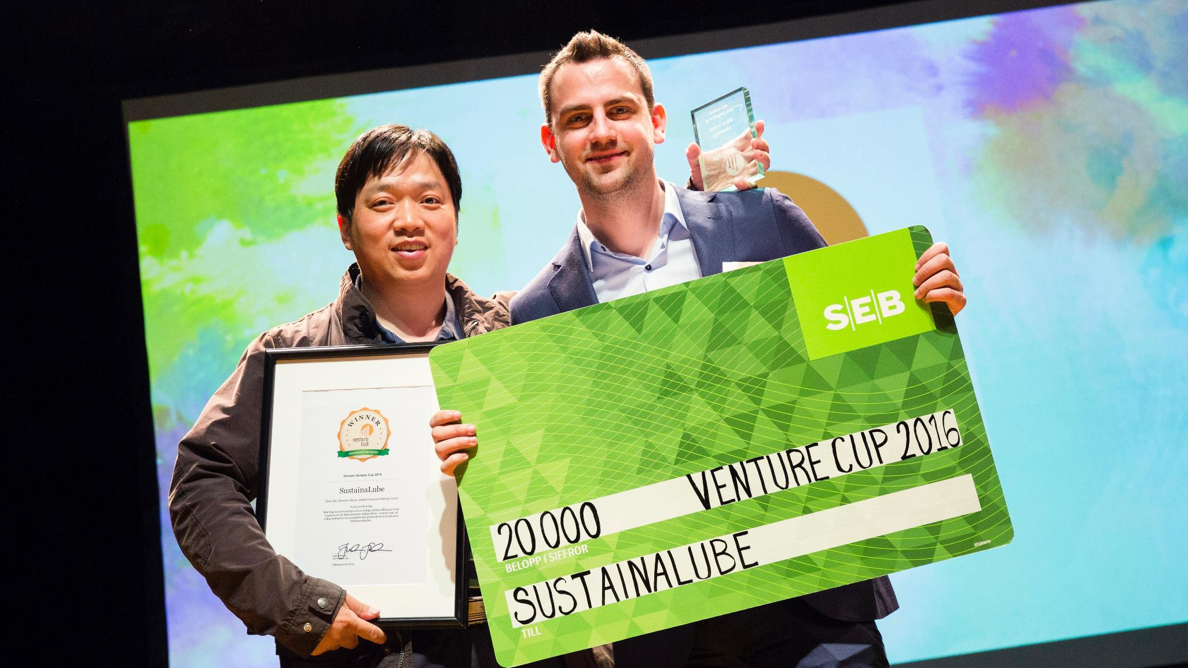
SustainaLube
Research group develops lubricant based on Glycerol. LTU Business does market validation and secures 2 million SEK innovation funding. ABI helps build a team and raise private capital.
Results:
Winners of env/energy cateroy in Venture Cup. Products commercially available. LTU student recuited as CEO, gets listed by Forbes on influential ’30 under 30’.

Slide 7
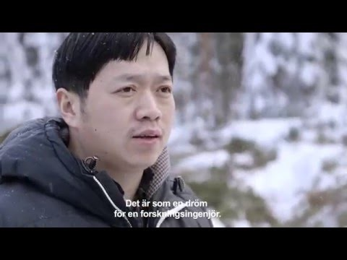
Exempel, Sustainalube
  VIDEO

Slide 8
Identification and Verification of Intellectual Assets

Slide 9









Innovation – when a solution fulfils a need
My work
Service / Product
creating value
?
Innovation
process

Slide 10
Your data from SIF #4

Slide 11

Start small – know your Intellectual Assets
My work
Knowledge
Intellectual Assets
Objectifiable, intangible
Intellectual Property
Legal definitions
Model
Design
Licenses
Trade secrets
Method
Software
Copyright
Patents
Data
Invention
Trademarks
IA Definitions courtesy of
Innovationskontor Väst (Chalmers)
Creative Commons BY-NC-SA

Slide 12
Start small – know your Intellectual Assets

Slide 13
Intellectual Assets
Structured approach to management of background / foreground
  Knowing what you have
  Making active decisions regarding your assets
Disseminate your research
Be better prepared for project collaboration
Strong foundation for innovation and commercialization

Slide 14




Innovation Due Diligence
incremental assessment of future potential over 3 phases
Current state
Target market select.
Commercialization strategy
Technology Brief
Starting point
Market focus
Identify markets/customers and test the need
Understand the market and how to reach it with profitability

Slide 15
Innovation Due Diligence - IDD
3 KEY PHASES OF IDD
IDD 0
IDD 1
IDD 2
Current state
Target market select.
Commercialization strategy
What
it is
Establishes an actionable and solid current state view of the innovation idea
What is is & What it does
Customer and Technology readiness level
Competing solutions
IPR
Feature/Benefit mapping
Identifies and tests the actual need in potential markets
Hypothesis driven mapping of potential markets
Interviews with key actors in value chains
Focus on future need and potential value
Deep dive market analysis to create a future go to market strategy
Analysis of chosen markets
Challenges/Opportunities
Future value chains
Competition
Market value and logic
What
it does
Provides a short comprehensive and communicable brief of the actual current state of the innovation
Provides a foundation for prioritization of
future efforts
Provides a solid and clear view on which markets that are of interest for further efforts/investments
Provides a first understanding of future markets and their requirements
Provides an actionable recommendation on where and how to get the innovation to a future market[s]
Provides an understanding of the risks/challenges, requirements and rewards

Slide 16
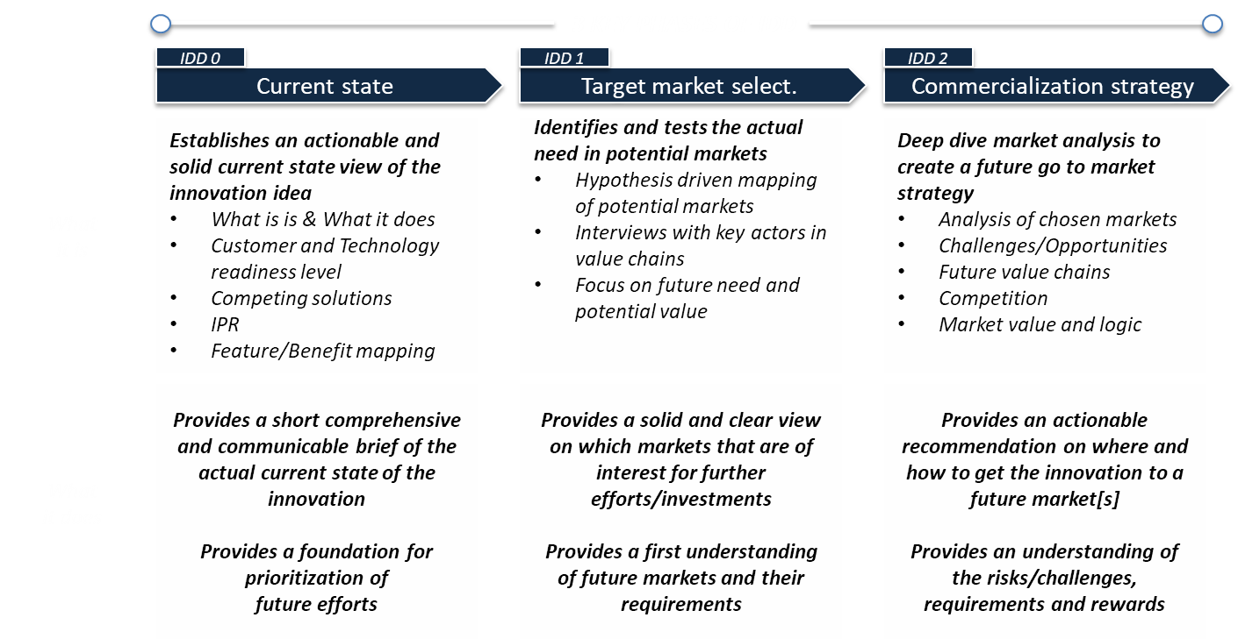
Workshop Introduction
A continuation of the work done at previous SIF’s
Try out some of the methods used by LTU Business

Slide 18
Tools
Real-time documentation using online tools
One laptop per group
Resources found at
  www.ritspace.se/events

Slide 19
SPACE INNOVATION FORUM #5, NOV 15 2017
workshop canvas – Technology Brief [IDD0 – Current State]
Title
< name it and frame it >
Group members
Name | Organization

Slide 20
Problem / Need
< In one sentence, describe what problem is solved (or need fulfilled) and if possible also for who >
Description
< Answer what it is and what it does using max 50 words – avoid tech jargon and how>

Slide 21
Main benefits
< Describe the most important/valuable benefits. Be specific, quantify where possible >
Benefit
Benefit
Benefit

Slide 22
Main benefits
Competitor | Competitor Advantages | Competitor Disadvantages | Your Advantages

Slide 23
Hypothesis to be verified
< Identify key hypothesis to be verified >

