Slide 1
Innovation management at NanoSpace
Space innovation forum 5
Johan Sundqvist
14-Nov-2017
Notes:
Shock test is mandatory according to launch provider

Slide 2
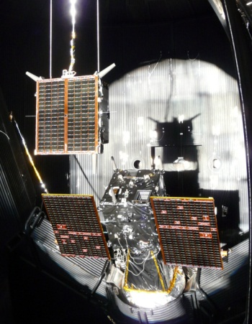
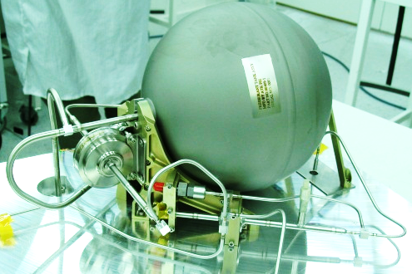
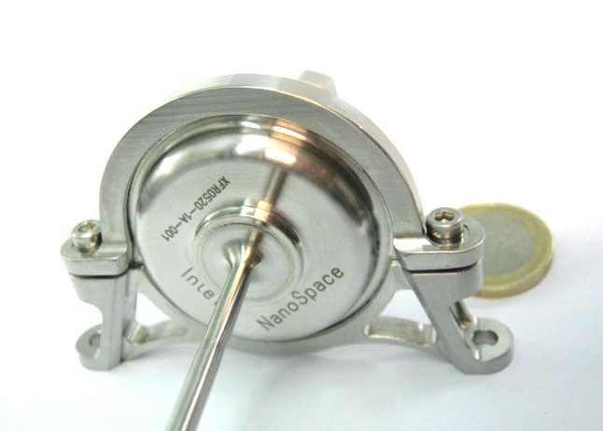
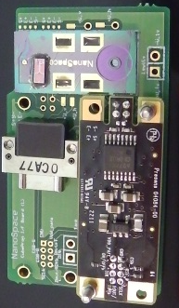
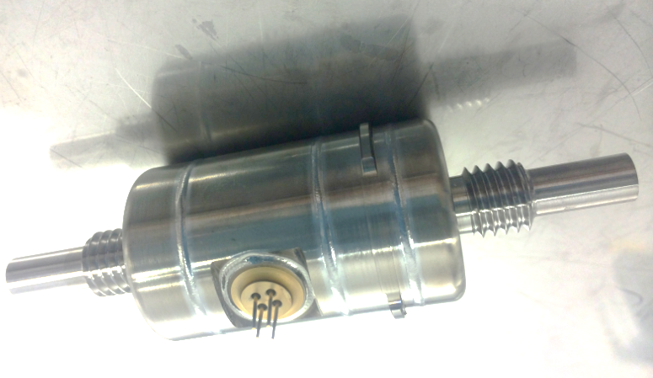
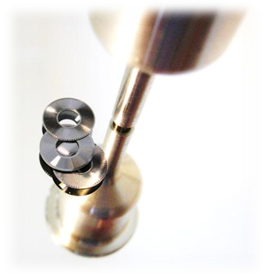
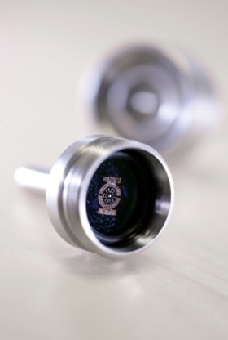
NanoSpace range of products
Propulsion systems
Cold/warm gas propulsion
Electric propulsion
Xenon Feed system
A gas handling system for Ion engines using Xenon as propellant
Individual sensors and actuators
Flow control valves
Isolation and safety valves
Filters
Sensors
Terrestrial applications

Slide 3
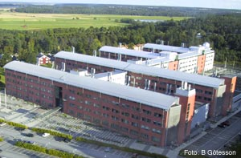
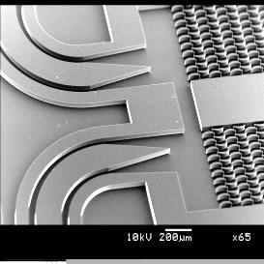
| Summary: 3 decades – 3 stages |
~1995 to 2004: Research
Talented people in a suitable environment: - the Ångström Laboratory in Uppsala
Timing – a decade ahead of the cubesat era
2005 to 2016: Development
Talented people: Researchers & engineers
Environment: incubated inside SSC
Timing – rapidly growing market
2017 -> : Industrialization
As part of GomSpace we want to be:
Leading in our niche
Growing in every aspect
Global reach
Notes:
Introduction: Short background on MEMS as technology and NanoSpace as company
Next: Messages..

Slide 4
NanoSpace workflow
Day-to-day work:
Small project/product groups
Weekly to monthly
Discuss progress, problems
Decide on new Engineering Actions
Updates from conferences, partner/competitor contracts, general market trends, etc
Workshops to solve tricky problems
A few times per year
Roadmap discussions
Spånskiva (innovation workshops)
Att ”spåna” = to brainstorm, improvise
”Skiva” = party

Slide 5
Innovation environment
NanoSpace is small, but with creative and talented personel
~ 50% PhD
~ 50% Lic + MSc
Everyone is up to date with market, technology, trends
Everyone knows that if we want to keep market lead we must innovate
Everyone agrees that the innovation process should be based on customer and market needs
Focus on what is needed, not technical solutions

Slide 6
Innovation environment, cont.
Predicting future trends and customer needs
Talk to customers
Talk to researchers
Participate in conferences, workshops
Cooperation with external experts
Industry
University
Systematic collection and evaluation of ideas
Organized outputs after workshops/spånskiva
REA/EA system – (Request for) Engineering Action

Slide 7
REA/EA – (Request for) Engineering Action
Good tool for collecting and tracking ideas

Slide 8
Propelling the new space era

