Slide 1

Practicalities within a EU project

Slide 2


Slide 3
Practicalities within a EU project
What is special with EU projects?
Regulatory documents
Funding
Reporting regularly
Meeting points
Activities
Dissemination of results
Follow-up / Evaluation / Lessons Learned
Audit and control
Time tracking (in-kind)

Slide 4

What is special with EU projects?
Based on “The Europe 2020 strategy” – GROWTH!
Regulatory documents
Cost efficiency
A separate accounting system
We apply for payment in arrears
Documentation for 10 years
Regular external evaluation
Communication – always the EU logo!
Purchasing - the Public Procurement Act
Not directed to the research community in the first place
We get 50% of the funding from EU
Notes:
The strategy is based on three overarching priorities that are mutually reinforcing:
- Smart growth developing an economy based on knowledge and innovation.
- Sustainable growth promoting a more resource efficient, greener and more competitive economy.
- Inclusive growth fostering a high-employment economy delivering social and territorial cohesion.

Slide 5
Conditions for RIT
3 years (+ 4 month to rap up)
37 MSEK (mostly saleries)
12 new jobs
Collaborative projects between LTU and LTU Business
In addition 10 partners
- Space industry: SSC, GKN, ÅAC Microtec, NanoSpace, OHB Sweden
- Support actors: ABI, Progressum, Kiruna kommun
- Financiers: Länsstyrelsen, NLL, EU
One project manager
Three subproject managers

Slide 6
SWOT - Strengths
LTU invests in space and took the lead for RIT (unique in Sweden)
Funding in place (unique in Sweden)
A strong project team in place
10 well established partners in the project
8 innovations projects up and running
The Graduate School of Space Technology (unique in Sweden)
Proximity to IRF and EISCAT (world class research – unique!)
Members of Space Kiruna
Esrange Space Centre (uniquely in Sweden, Europe)
5 of Sweden’s strongest space companies on boardRexus & Bexus
Space Campus (unique in Sweden)
Kiruna is a Space City with broad experience and expertise
Broad experience and expertise in innovation support
Established processes and methods for effective innovation support
A ESA space incubator established Q4 2015
Strong national and international networks

Slide 7
SWOT - Opportunites
Society need space (GPS, climate observations, communication etc)
The geographic location with unique space phenomena
Development projects within Space Kiruna (SSC, IRF, EISCAT etc)
Connect academia - industry - innovation support
Exotic environment - attractive space environment (Northern lights)
Additional national and international partners
We are in step with the Swedish Space investigation
Industry can increase R&D projects with Space Kiruna actors
Industry can interact more with space education
Possible to strengthen the research infrastructure
ESA has strong budget for applications (Galileo and Copernicus)
New research themes of space (Additive manufacturing, lubricants, etc.)
Collaboration with other industries - technology transfer
Experience within EIT (European Institute of Innovation and Technology)
Experience within KIC (Knowledge and Innovation Communities
Space is fascinating - huge interest
Space is an industry of the future
New Esrange – launch small satellites
Regional SMEs can be involved
Collaboration with ESA/BIC

Slide 8
SWOT – Weaknesses and Threats – RISKS !
Difficult to recruit the right skills
Long time to commit (3 years) - Can we keep the project participants' interest alive for three
Is the project well anchored amongst the project partners?
Financing “In kind” is a risk
The project partners are geographically dispersed
TVV and EU makes it complicated
Matrix organization – and new (immature?)
Individual dependent (key persons)
Multiple languages - communication difficulties?
The parties have different driving forces
Are supervisors positive to commercialization?
Fear of "open innovation"
Engagement - some are short of time and have hard to say "no“
EU does not accept our reports / expense (recovery)

Slide 9
Regulatory documents
The Decision from TVV (Swedish Agency for Economic and Regional Growth)
TVV's website for requirements etc.
http://eu.tillvaxtverket.se/genomfora.4.4e043d611454b1662ff7cc5.html
Collaborative Agreement
Project Agreement
Project Plan
Communication Plan
Follow-up Plan

Slide 10
Fundings
For in kind
Crucial to report
time and expenses

Slide 11
Reporting periodically
Status Report 2 times a year
Including eventual deviations and suggestions on how to correct them
to regularly inform TVV
to inform the project staff, steering committees and reference groups
to keep all involved on track
Annual Report in December
the third Status Report of the year
Final report at the end of the project

Slide 12
Reporting periodically
Who will report?
- PL and the project group (WP1, WP2 and WP3)
- Supervisors and the PhD students
Status and Annual Report
Deadlines for all involved
Final report at the end of the project
PL and the project group + Sanna, Reza, Javier)
 | Reporting period
1 | 2015-09-01 to 2015-12-31
2 | 2016-01-01 to 2016-03-31
3 | 2016-04-01 to 2016-08-31
4 | 2016-09-01 to 016-12-31
5 | 2017-01-01 to 2017-03-31
6 | 2017-04-01 to 2017-08-31
7 | 2017-09-01 to 2017-12-31
8 | 2018-01-01 to 2018-03-31
9 | 2018-04-01 to 2018-08-31
10 | 2018-09-01 to 2018-12-31
 | To PL and Controller
1 | 2016-01-31
2 | 2016-04-30
3 | 2016-09-30
4 | 2017-01-31
5 | 2017-04-30
6 | 2017-09-30
7 | 2018-01-31
8 | 2018-04-30
9 | 2018-09-30

Slide 13
Meetings and Meeting Points
Steering Commettee / Board of Directors / Reference Group meetings
Project Group meetings
Work Package meetings
Supervisor – PhD student – Space company
Supervisors – PhD students – Space companies
Meetings including RIT and the Garduate School of Space Technology
Six ”Meeting Points” during the project
Workshops lunch – lunch
Students-PhD:s-Scientists-Engineers-Entrepreneurs-SME:s etc

Slide 14
Activities
Project management
External communication and dissemination of results
Evaluation and learning
Clearance work
Skills and competitive development – WP 1 Centre of Excellence
Work with innovation projects – WP 2 PhD innovation projects
Initiate an innovation support systems in the aerospace industry – WP 3 Innovation support system

Slide 15
Follow-up-Evaluation-Lessons Learned
”Följefoskare”
Will follow-up the project
Continuous learning in the projects
A tool to help us keep the right direction
Quality assurance

Slide 16
Time tracking – only for ”In kind”
Routines
How?
What?
When?

Slide 17


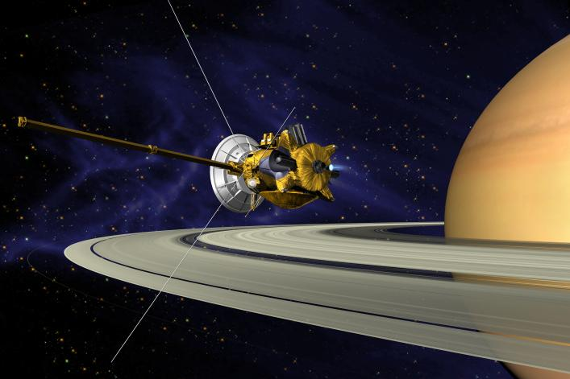
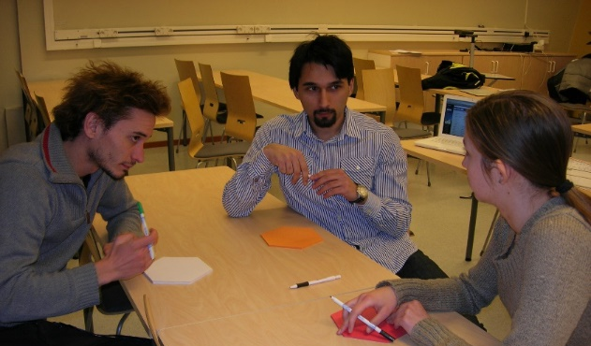
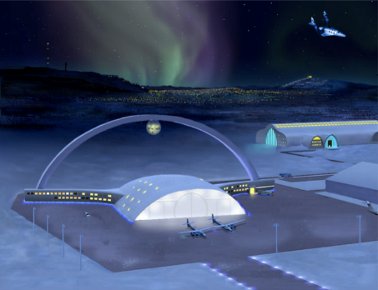
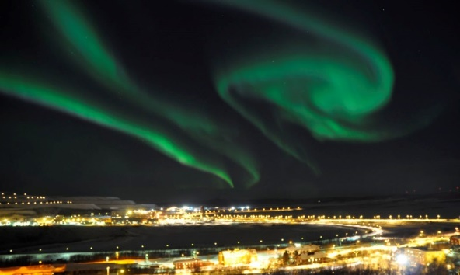
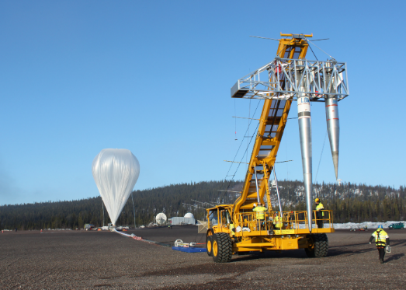
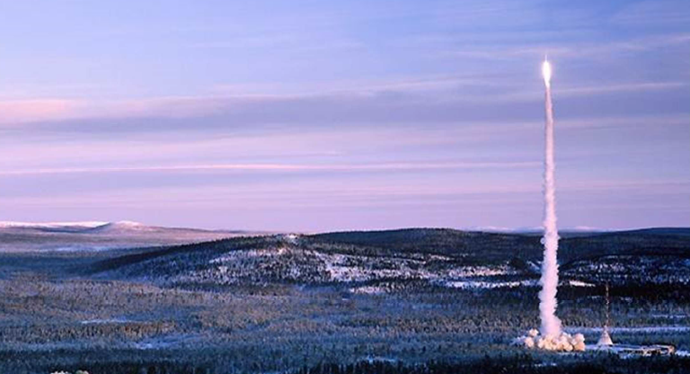
Tack!

