Slide 1
Johanna Bergström-Roos
Project Manager
LTU Business

Slide 2
Cofinancing by
Partners
Operated by

Slide 3
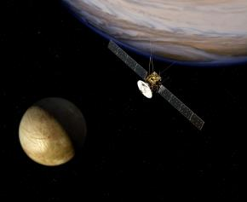
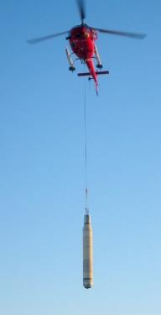
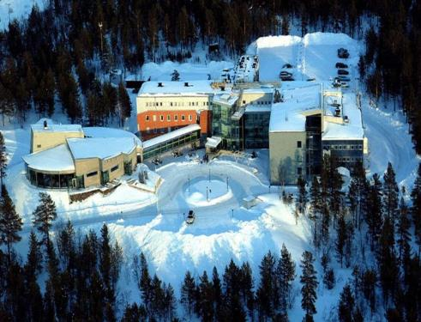
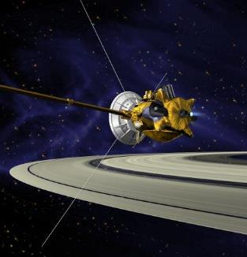
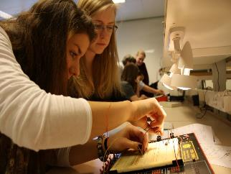
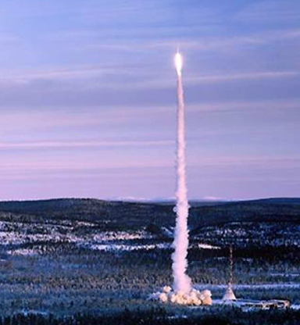
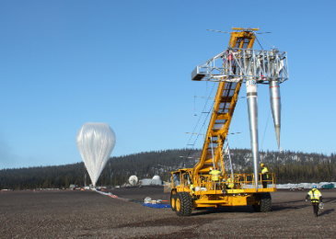
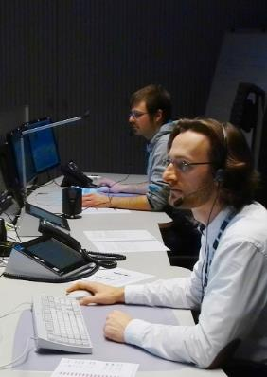
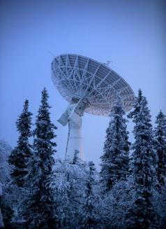

Slide 4
Purpose & Goal
Perpose The space sector will contribute to increase growth in the region on a much broader scale than it does today.
Strong links local-regional-national-international
Overall Goal
The region has a current and well anchored space strategy, linked to the Swedish strategy for space.
Project Goal
The space sector in the region has increased its capacity in R&D collaboration between academia, industry and stakeholders in the innovation support system.

Slide 5
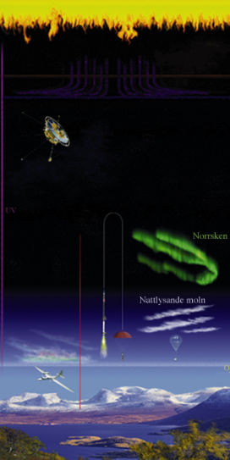
Unique conditions
New
initiatives
EISCAT 3D
New Esrange
LTU’s space investment
Space Lab
Planetary Exploration Center
Centre of Excellence for Space Technology
NanoSatLab
Commercial spaceflights
Esrange Space Centre
Space Campus
Geographic location
An established space town
Experience since the 50th
International network

Slide 6
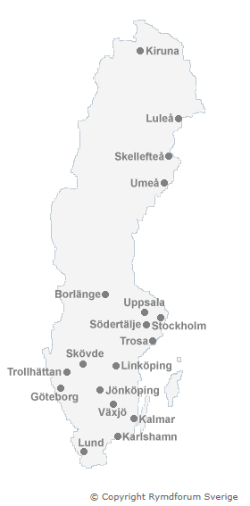
Spin-offs
Satmission
NordNav
TeleWide AB
ÅAC Microtec
NanoSpace
BruhnSpace
NanOSC
Wasa Millimeter Wavws
ECAPS
C2SAT
Spacemetrics
Brockman Geomatics
Aeroflex Geisler
Forsway Scandinavia
Spectrogon
Spectrogon
Speed Power
IRnova
Polymer Kompositer
Omnisys Instruments
Umbilical Design
Comlase
YoYo Technology
Carmenta
Imego AB
Gotmic
Instrument Control Sweden
STARCS
APR Technologies
DST Control

Slide 7
What drives spin-offs?
A driving force
Skills and higher education
Amount of R&D projects – new ideas
Technical development
Economic policy
Funding
A critical mass of minds
Infrastructure

Slide 8
Before th RIT project
Research
Product development
Market
Sale
Academy
Industry
Industry
Industry
No external innovation support system is used

Slide 9
After the RIT project
Research on demand
Product development
Market
Sale
Academy – Industry – Innovation support system
Industry – Innovation support system
New methodes
New processes
New sorfware
Nya produkter
Nya tjänster
Nya företag
New models
New data
New design
Nya produkter
Nya tjänster
Nya företag
New
products
New services
New companies

Slide 10
Strengthening
R&D collaboration
Academia - Space Sector - Innovation Support System
WP1
A Centre of Excellence for Space Technology
WP2
R&D projects between Acadamia and Space Sector
WP3
An innovation Support System for Aerospace
Notes:
RIT stands for “Rymd för innovation och tillväxt” which is ”Space for innovation and growth” in English.
RIT is an EU funded project co-operated by LTU and LTU Business with the objective to create sustainable growth in Norrbotten and strengthens Sweden as a space nation. This by strengthening R&D collaboration between academy, the space sector and the innovation support system.
RIT will build a productive and attractive innovation environment to attracts people, investors and companies to the region.
The partners involved in the project belong to academia (LTU), Swedish space industry (SSC, GKN, NanoSpace, OHB Sweden, ÅAC Microtec), regional innovation support system (LTU Business, Arctic Business Incubator (ABI), Progressum) as well as the public sector (Kiruna Municipality, Norrbotten County Administrative Board, Norrbotten County Council (NLL)).
Work Package 1 - Establish a Center of Excellence in Technology in Kiruna
- This Center of Excellence establishes an attractive test and development arena in the region for space industry and academia.
- Cooperation between space actors creates synergies that strengthen the region's attractiveness and ability to grow.
- At the end of the project the project participants runs the arena together and a strong commitment has been created to continue to operate the research center.
Work Package 2 - Implement joint R&D space projects
- Actors in the space sector increases their skills in R&D by running joint projects.
- Initially eight R&D projects, related to the needs of the space industry, are implemented. The goal is that additional innovation projects take shape during the project.
- At the end of the project at least eight new products or services are identified for further development toward commercialization.
Work Package 3 - Initiate an innovation support system for the space business
- The support system for innovation examine the commercial prospects for new business ideas, where great emphasis is put on analysing the market's interest.
A number of creative meeting places are implemented, in order to stimulate interaction between space industry, academia and regional entrepreneurs.
At the end of the project the support system will contribute so that new knowledge and ideas benefit to mankind.

Slide 11
What shall we deliver?
WP 1 | WP 2 | WP 3
A Centre of Excellence | 8 PhD students half way through their education Identified 8 products or services for commercialisation | Initiate an innovations support system Involve 15 regional SME:s in the space business

Slide 12
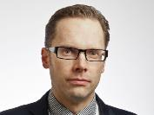
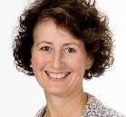
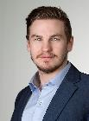
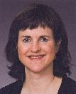
Organisation
Styrgrupp
Jonas Ekman LTU Project owner
Gry Holmgren Hafskjold
LTU Business Interaction party
Projektgrupp
Johanna Bergström-Roos
LTU Business, Project manager
WP 1
Centrumbildning
WP 2
Innovationsdoktorander
WP 3
Innovationstödsystem
Mattias Gustafsson
Trainee, LTU Business
Olle Persson, LTU Centre of Excellence
Marta-Lena Antti, LTU Gratuate School of Space Technology
Johanna Bergström-Roos
LTU Business, Innovation Support

Slide 13
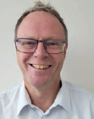
Establish a Centre of Excellence
Create a development arena for academia and industry
Be based on the needs of industry
Make the expertise available
Invite SME's, entrepreneurs, inventors, other industries etc
Implement the innovation support system
Implement commercialization and entrepreneurship
Establish new networks
Olle Persson

Slide 14
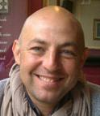
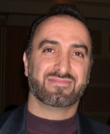
Establish a Centre of Excellence
Create a development arena for academia and industry
Be based on the needs of industry
Make the expertise available
Invite SME's, entrepreneurs, inventors, other industries etc
Implement the innovation support system
Implement commercialization and entrepreneurship
Establish new networks
Maria-Paz Zorzano Mier
Olle Persson
Javier Martin Torres
Reza Emami

Slide 15
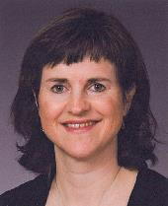
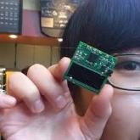
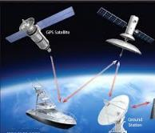
R&D projects
8 R&D projects
Already 2 additional ……..
Research based on the needs of industry
Research based on the academic competence
Recruit and educate innovation PhD
Involve SME if posible
Create bridges between industry and academia
Marta-Lena Antti

Slide 16
8 Innovation PhD’s
Facilitation of innovation within space manufacturing (2 PhD:s)
SMARTi – Links between additive metal deposition process and the mechanical properties of Ti-6Al-4V (Samband mellan additiv Metalldeponeringsprocess, mikrostruktur och mekAniska egenskapeR för Titan)
Software-defined radio for ground-based satellite communication
ANSHAB - Autonomous Navigation System for High Altitude Balloons (New measuring method for balloon-borne stratospheric wind profiling )
Development of the instrument HABIT (for ExoMars 2020)
MicroPILS – Micro Propulsion In the Loop Simulations
Formation flying in space – on-board systems to calculate trajectories etc.

Slide 17
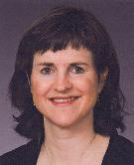
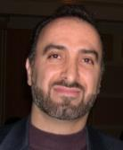
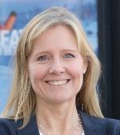
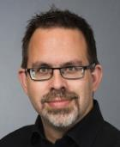
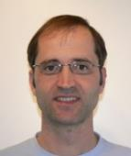
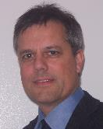
Supervisors RIT
Marta-Lena Antti
Reza Emami
Anna Öhrwall Rönnbäck
Peter Törlind
Javier Martin Torres
Thomas Kuhn
Maria-Paz Zorzano Mier
Jaap van de Beek

Slide 18
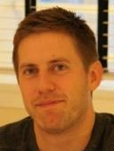
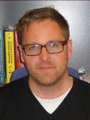
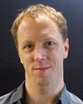
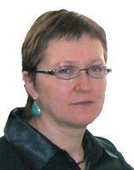
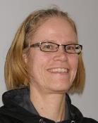
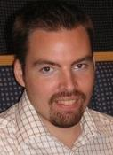
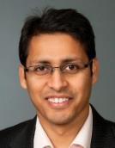
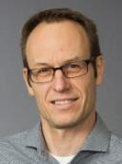
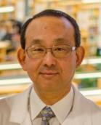
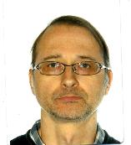
Supervisors Graduate School
Marta-Lena Antti
Reza Emami
Anna Öhrwall Rönnbäck
Peter Törlind
Javier Martin Torres
Thomas Kuhn
Maria-Paz Zorzano Mier
Jaap van de Beek
Rikard Slapak
Jana Mendrok
Mathis Milz
Lars-Göran Westerberg
Mattias Grahn
Hans Nilsson
Eugenia Belova
Gabriella Stenberg
Johan Kero
Vinit Parida
Magnus Gustavsson
Ichiro Minami
Robert Person
Peter Völger

Slide 19
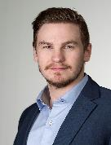
Innovation Support System
Develop cooperation within the innovation system
Create innovative venues for stakeholders in the space sector
Develop the methods and processes for innovation and commercialization
Conduct inventory of results
Capture potential business ideas
Verify and develop potential business ideas – ESA BIC Sweden
Mattias Gustafsson LTU Business

Slide 20
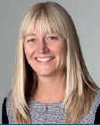
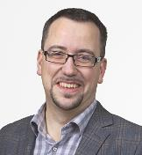
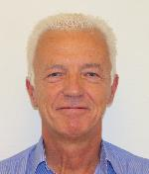
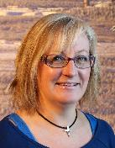
Innovation Support System
Mattias Gustafsson LTU Business
Johanna
Bergström-Roos LTU Business
Pär Johansson LTU Business
Jens Lundström ABI/ESA-BIC
Joakim Enerstam ABI/ESA-BIC
Tommy Lahti Progressum
Ann-Christin Samuelsson Kiruna kommun

Slide 21
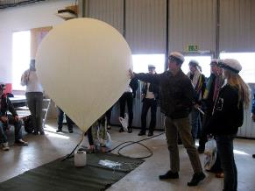
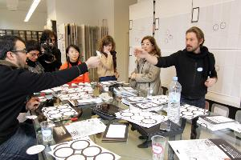
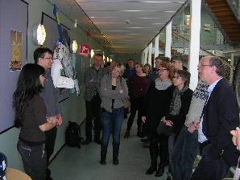
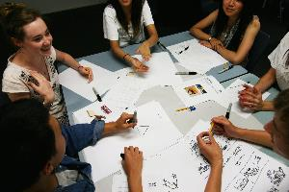
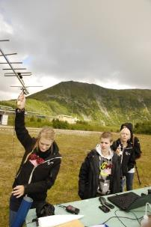
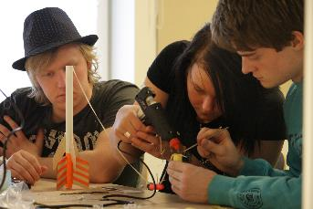
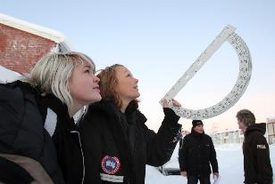
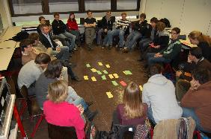
20 PhD students - 180 graduate students
Notes:
5th International Workshop of LunarCuces A hackathon (also known as a hack day, hackfest or codefest) is an event in which computer programmers and others involved in software development and hardware development, including graphic designers, interface designers and project managers, collaborate intensively on software projects.^{[1]} Occasionally, there is a hardware component as well.
Hackathons typically last between a day and a week. Some hackathons are intended simply for educational or social purposes, although in many cases the goal is to create usable software. Hackathons tend to have a specific focus, which can include theprogramming language used, the operating system, an application, an API, or the subject and the demographic group of the programmers. In other cases, there is no restriction on the type of software being created.
The term "hackathon" has also been used as a term for more general "focused innovation efforts" that includes non-coders and community members, such as in the Palo Alto civic hackathon event Hack Palo Alto.^{[2]}

Slide 22
SME:s in the region
SSSSSSSS
SSSSSSSS
XXXXXXXXXX
OOOOOOO
FFFFFFFFFF
OOOOOOO
ZZZZZZZZZZ
YYYYYYYYYY
XXXXXXXXXX
YYYYYYYYYY
ZZZZZZZZZZ
PPPPPPP
QQQ
PPPPPPP
QQQ
RRRRRRR
LLLLLLLLLL
RRRRRRR
LLLLLLLLLL

Slide 23
Create Meeting Points
Steering Committee/ Board of Directors/ Reference Group meetings
Project Group meetings
Work Package meetings
Supervisor – PhD student – Space company
Meetings including RIT and the Garduate School of Space Technology
Six ”Space Innovation Forum” during the project Workshops lunch – lunch Students-PhD:s-Scientists-Engineers-Entrepreneurs-SME:s etc

Slide 24
Tack!

