Slide 1
Testbeds for
Space Systems
SPACE
INNOVATION
GROWTH
COOPERATION
Olle Norberg

Slide 2
TESTBED?
What is that?
JOIN US

Slide 3
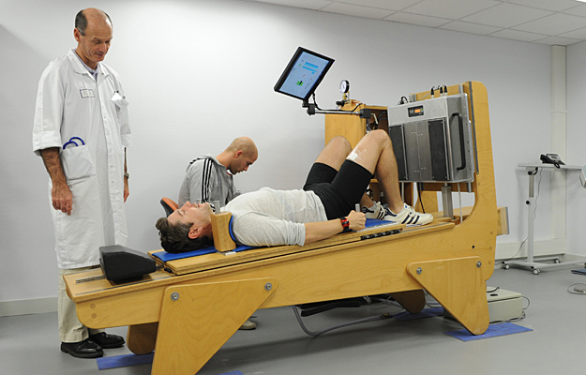
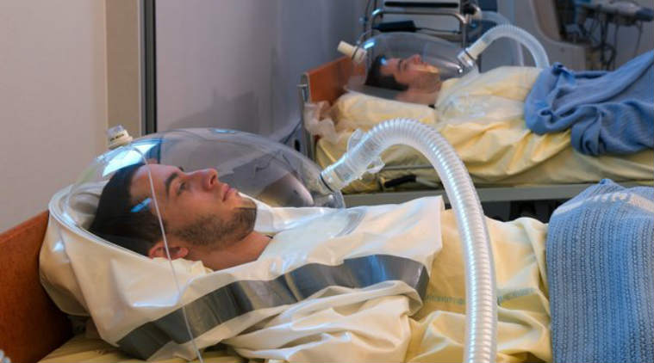
Well, this is bed rest tests, used for studying effects of microgravity on the body.

Slide 4
Testbeds are platforms and environments for experimental testing for research and product development

Slide 6
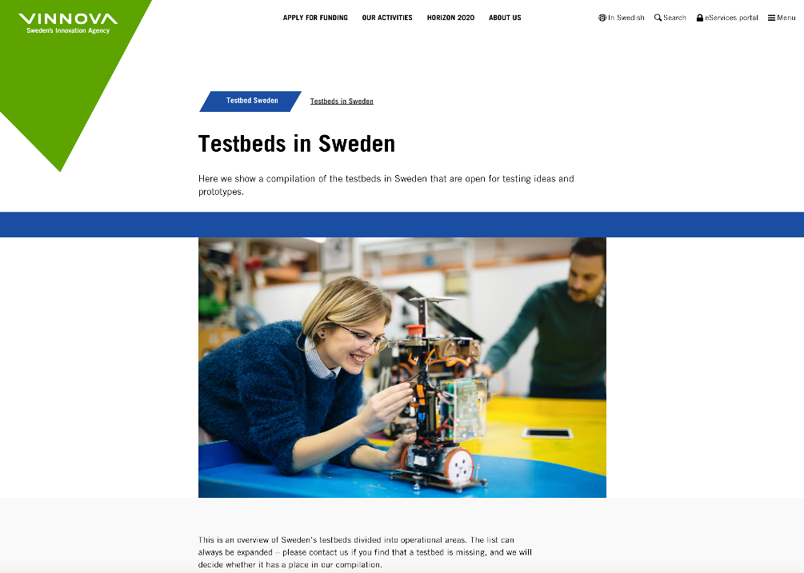
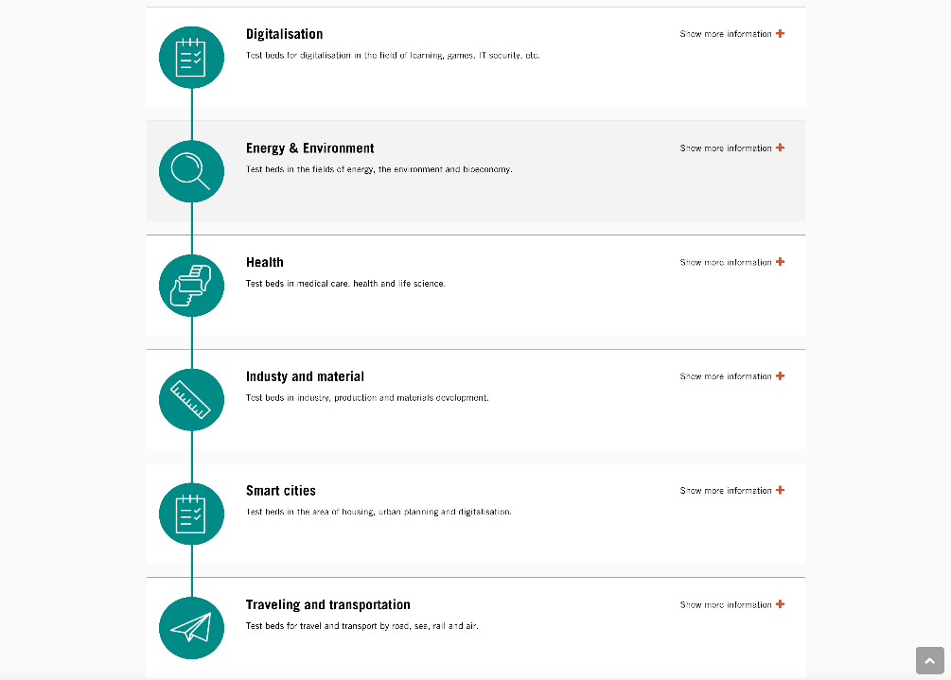

Slide 8
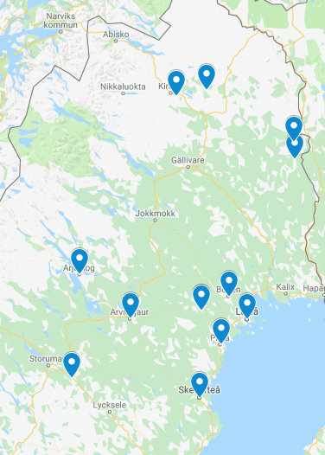
Vehicle system testbeds in northern Sweden
Icemakers Arejplog Full Service
Arctic Falls Älvsbyn Facility
Arctic Arc Lappland Full Service
Swedish Proving Ground Association
Ytterligare klient- information avslöjas ej
Plus: Alfa Romeo, American Axle, Audi, Autoliv, BMW, Renault, Borg Warner, Bosch, Bridgestone, Continental Teves, Daimler, Dunlop Tech, EvoBus, Ferrari, Fiat, GKN, Haldex, HMC, Jaguar, Knorr-Bremse, Lancia, Land Rover, Magna Powertrain, MAN, Mando, Opel, Pirelli, Porsche, PSA, Ricardo, Seat, Skoda, TRW, Volkswagen, ZF and others

Slide 11
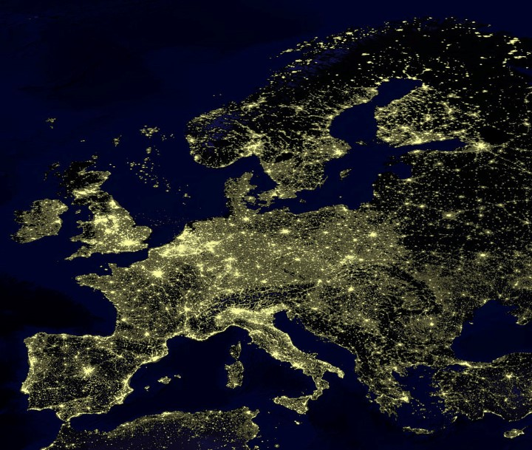
THE LEAST POPULATED AREA IN EUROPE

Slide 12
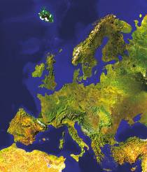
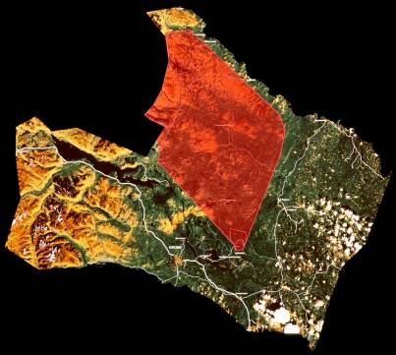
ESRANGE SPACE CENTER IMPACT AREA FOR ROCKET PAYLOADS AND BALLOON DROP TESTS
Norway
Finland
5200 km²
ground space
Kiruna
Esrange

Slide 13
Drop tests from balloons and rockets
Stratospheric balloons are used for drop tests of aerospace vehicles, re-entry bodies and parachute systems.
Free falling objects weighing up to 2 tonnes
Drop altitude up to 40 km
Telemetry and tele-command during ascent and drop phase
Recovery of object with helicopter
Sounding rockets are used for drop tests of re-entry bodies and parachute systems.
Free falling objects weighing up to 50 kg on dedicated flights
Release altitude up to 700 km
Recovery of object with helicopter

Slide 14
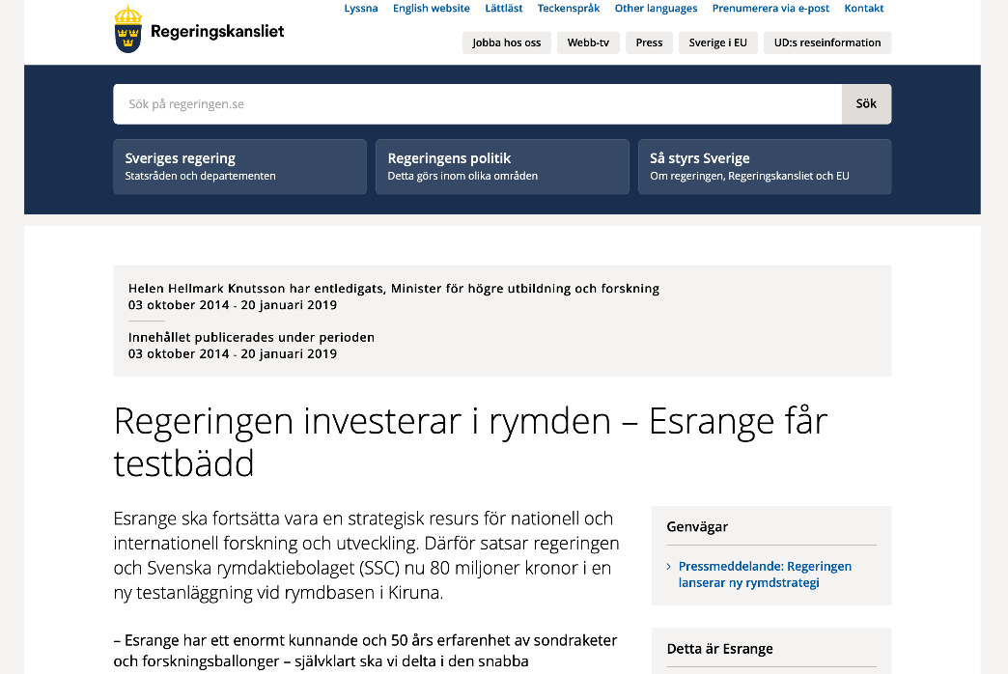
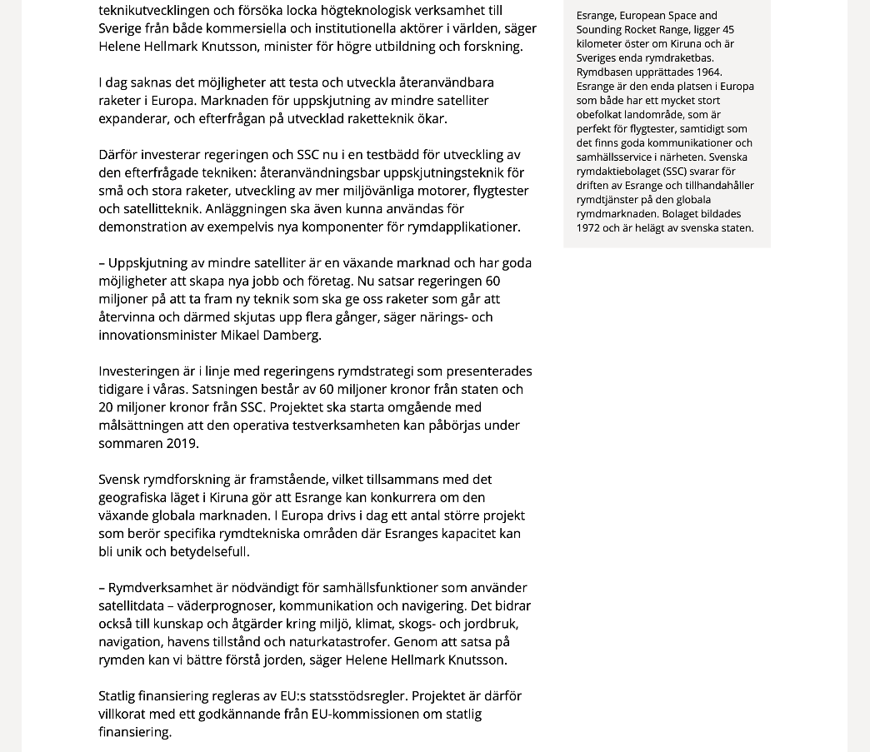
9 July 2018:
The government invests 60 MSEK and SSC 20 MSEK in a testbed focused on launch vehicles.
The government and SSC is therefore investing in a testbed for development of the desired technology: reusable launcher technology for small and large launch vehicles, development of more environmentally friendly motors, flight testing, and satellite technology. The facility will also be possible to use for demonstration of for example new components for space applications.

Slide 15
Meanwhile, the space economy is changing rapidly
So how can we connect, co-operate, contribute?

Slide 16
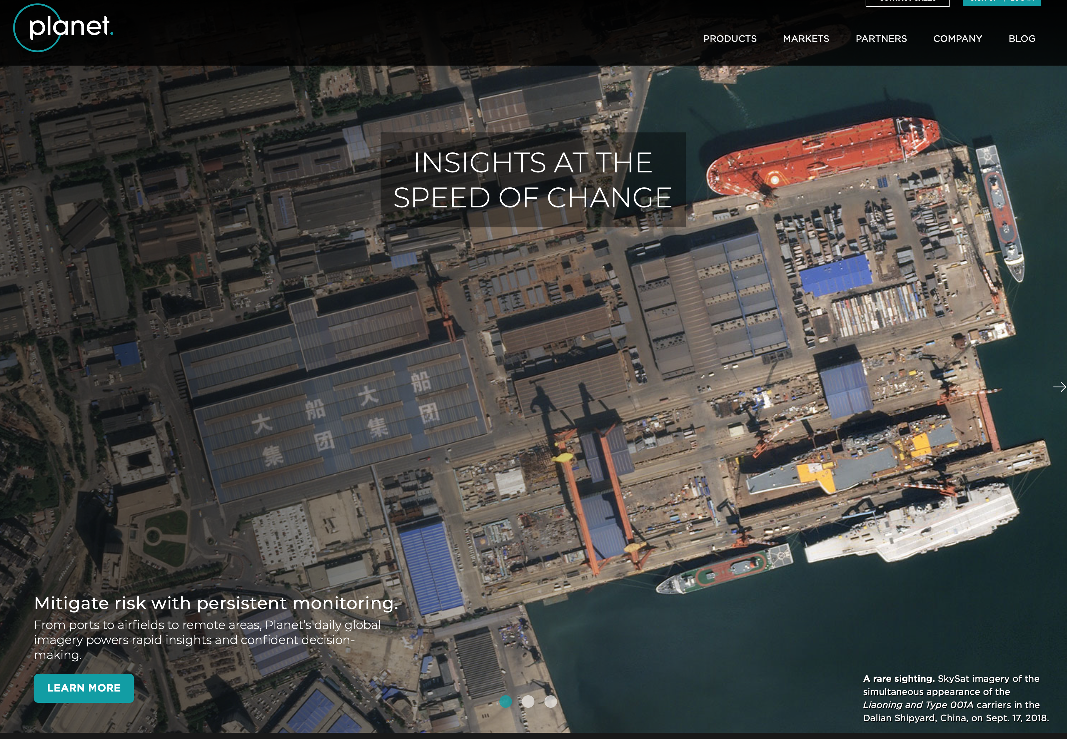
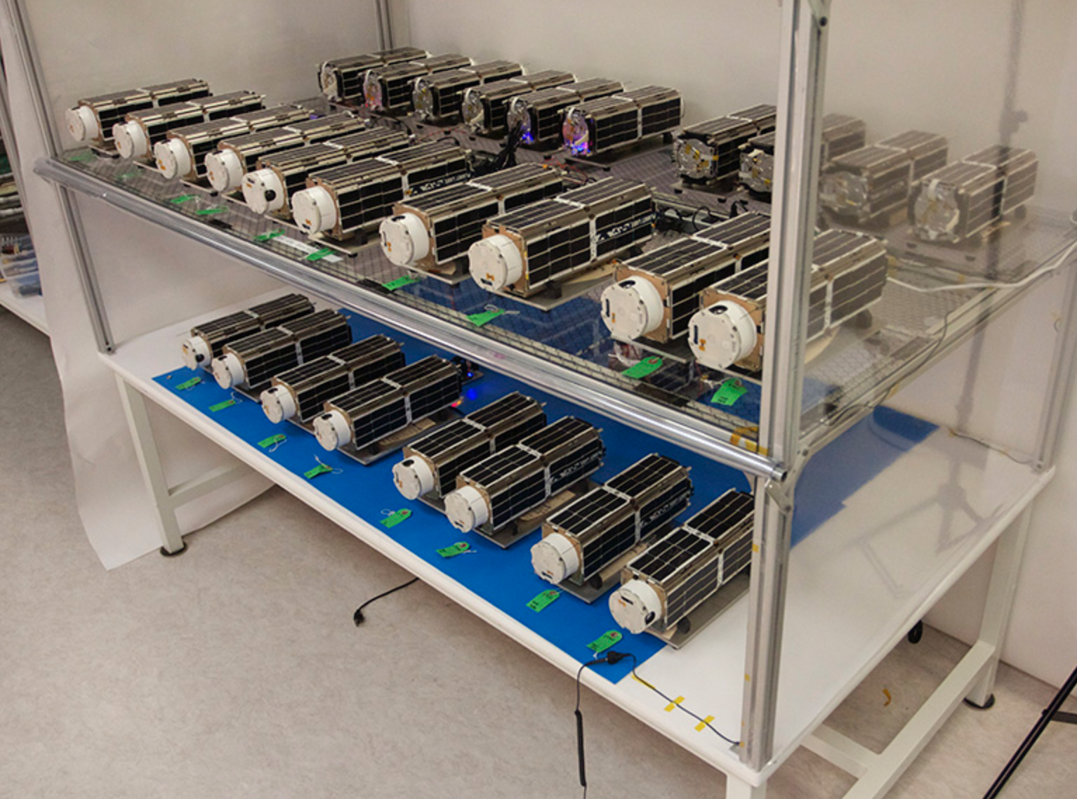
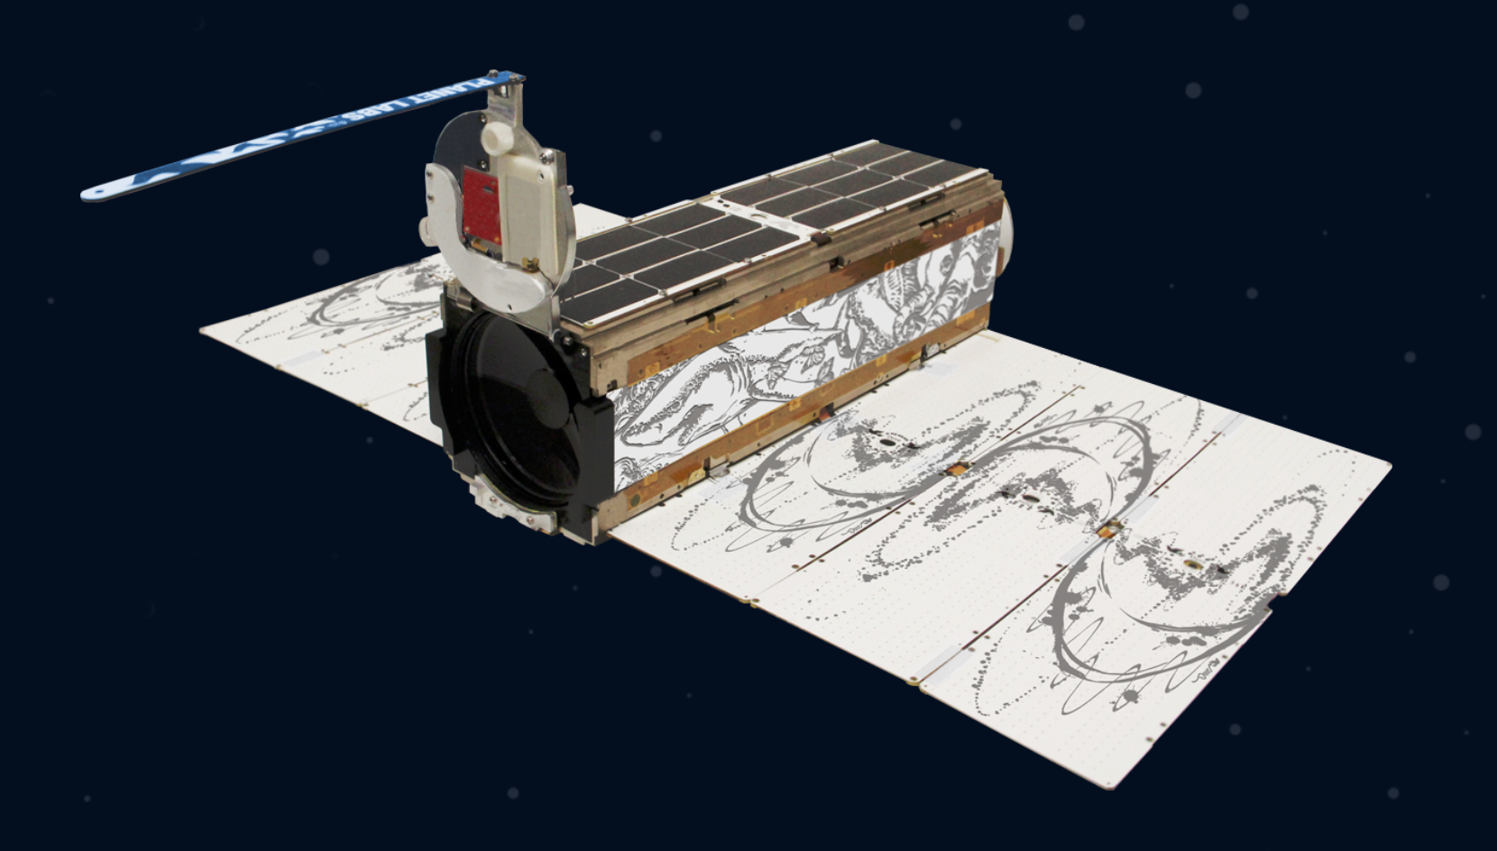
THE NEW SPACE ECONOMY
Many new actors, faster development cycles, iterative development – all this means the need for testing of space systems will increase – a lot.

Slide 17
Our goal is to create a coherent Space Systems Testbed in Northern Sweden, by including the…
Existing and future facitlities and competenices at Esrange Space Center, IRF, EISCAT, and LTU
Competences and commersial vision of PASQ
Long term testing experience of Swedish Space Industry such as OHB, RUAG, GKN, SSC
New Space experience of companies such as GomSpace, ÅAC Microtec / Clyde
Incubation services, ESA-BIC managed by ABI
Vision and determination in Finland by working with several Finnish organisations
And of course including everyone wanting to join in
Workshop tomorrow at Camp Ripan

Slide 18
Case 1: How can we leverage the facilities and knowledge at IRF to support the developing new space economy?
Máté Kerényi, IRF

Slide 19
Case 2: Can the reasearch at IRF contribute to an app for auroral forecasts that beats the competition?
Johan Kero, IRF

Slide 20
Four questions:
What are the big challenges in space systems testing?
How can Northern Sweden become competitive with a space systems testbed? What are our Unique Selling Points (USP’s)?
How can we make 1 + 1 = many? What makes us larger than the sum of the parts? Space Kiruna in the future? Opportunities? Challenges?
How is your organisation prepared to contribute? Be visionary! External funding?

