Slide 1

RIT2021
SPACE
INNOVATION
GROWTH
COOPERATION
Olle Persson & Margareta Bäckström Lindgren
4-5 September 2019

Slide 2
Research infrastructures
& Testbeds
– Are there any differences?

Slide 3
Research infrastructures & Testbeds
– Are there any differences?
Department
Ministry of Enterprise and Innovation
(Näringsdepartementet)
Ministry of Education and Research
(Utbildningsdepartementet)
Funding Agency
VINNOVA- Sweden´s innovation agency
Swedish Research Council (Vetenskapsrådet)
Definition
TESTBED
Research infrastructures

Slide 4
VR definition: Research Infrastructures in Sweden
Research infrastructures are advanced tools for research
Researchers may need advanced tools to be able to carry out their research - so-called research infrastructure.
Examples are databases, research facilities, biobanks and large-scale calculation tools.

Slide 5
VINNOVA -Testbeds the Swedish concept
Dates back to April 2011in the Ministry of Industry's official documents.
Served as the basis for the research and innovation proposition in 2012.
Directions of Vinnova's (Sweden´s innovation agency) strategies and priorities.
The background is that Sweden needs to increase its commercialisation of innovations.

Slide 6
VINNOVA -Testbeds the Swedish concept
Innovation systems addressing major social challenges requires collaboration between the different actors.
Experience exchange and knowledge is vital in the process from identification of needs to introduction of new products, services and processes in the market.
Focus on collaboration with customers in the development and commercialisation process is something that has not been as pronounced earlier.
Test and demonstration in real environments is an critical part in innovation and commercialisation processes.
Testbed Sweden is our government´s industrialisation strategy.
Notes:
Testbädd är en fysisk eller virtuell miljö.
De ska vara öppna för användare utanför den egna organisationen och kunna användas under längre tid av flera olika aktörer.

Slide 7
Feedback from a Testbed manager
Prepare long-term funding, number of employees and their skills.
Permanency among the employees in order to develop new projects/tests.
Funding for basic investments and collaboration with local entrepreneurs to attract customers.
High service, good basic offerings as well as unique offerings and flexibility to adjust to different needs/customers.
Find the “extra quality” at the same cost as customer has to pay back home.
Infrastructure around the company/researcher/customer visit depending on the timeframe of the service.

Slide 8
Project FOINFRA@LTU2018

Slide 9
Definition of a LTU Research infrastructures
A facility (equipment, installation, database, knowledge collection, services, virtual or other resource) with associated personnel expertise, which is necessary to conduct top quality research.
Local or part of national or international infrastructure
Open and accessible to all researchers at LTU on equal terms
Collaborative environment (internal and external)

Slide 10
General principles:
LTU Research infrastructures
Meet the needs of research at universities
Level division for responsibility and control within the infrastructure
Long term (<10 years) - economy and state of the art
Systematics for the university's priorities

Slide 11
Future LTU organisation
National/international
Research infrastructures
3
LTU
Research infrastructures
2
Implementation 2020 of the results from FOINFRA@LTU2018
Institutions
Lab and Equipment
1

Slide 12
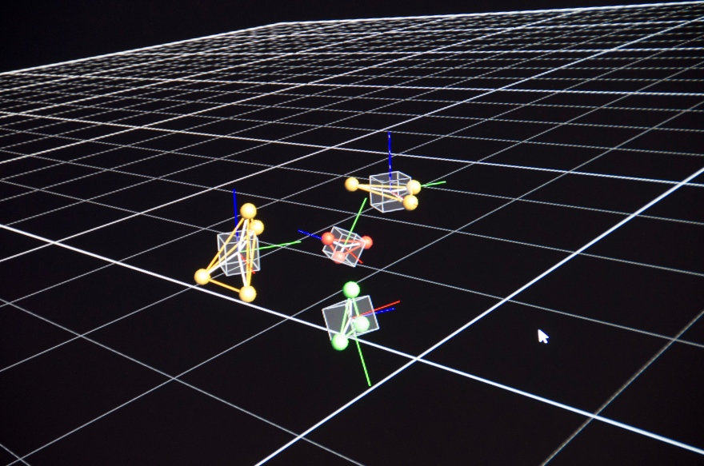
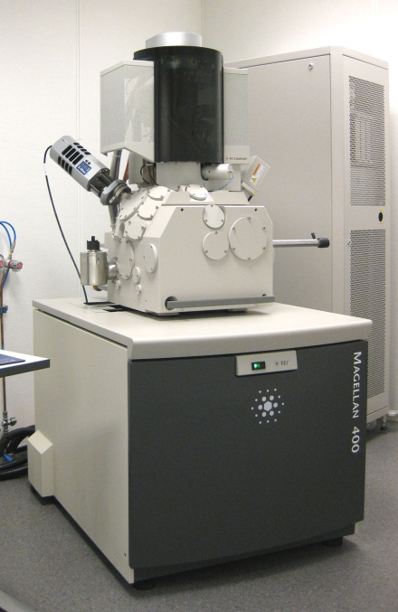
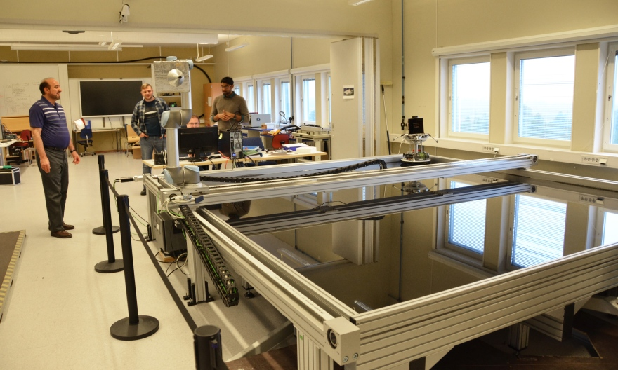
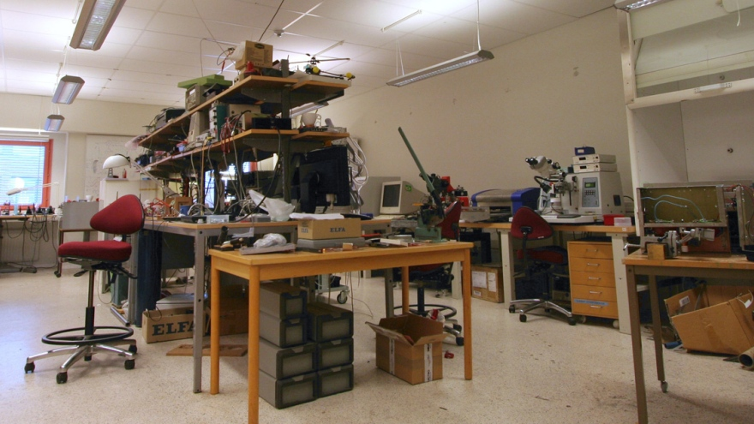
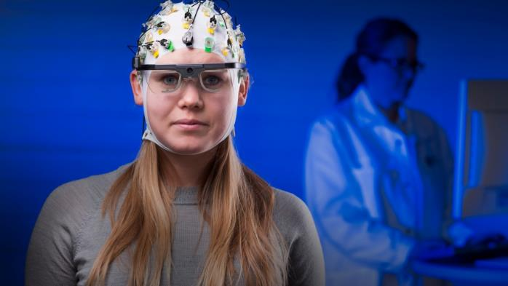

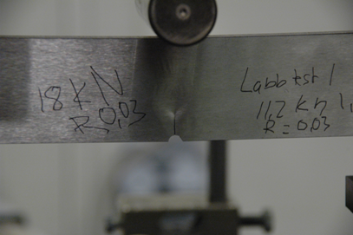
Avaliable inst lab at LTU

Slide 13
SRT
Gender Contact Point
Arena for cooperation
Botnia Living Lab
LTU security lab
Ultrasonic laboratory
FROST Lab
Nano SAT Lab
Meteorite Lab
Inspire Lab
Software defined Radio Lab

Slide 14
ETS
Machine Learning Lab
DEPICT LAB
Vehicle driving simulator
Design lab

Slide 15
TVM
Pehr Högström laboratory
Welding machine
CT lab
Raman microscope
Dynamic lab
Wood machining lab
Terrain vehicle platform
Sweep probe microscope (SPM, AFM) TVM
Surface Science and Interfacial Engineering (SUSIE) centrum
Tribolab
Flow mechanics lab
Laser lab
LTU Green Fuels
High energy laser laboratory
Microtomography lab
Optical lab
Beräkningskluster
Wood science and engineering
Chemistry lab
TMTEST
Nano4Energy
ECO-lab

Slide 16
SBN
LTU Stress trailer
Sweep electron microscopy, SEM SBN
CBM Lab
eMaintenance Lab
Micro sensor equipment
NMR, IR and Raman spectroscopy lab
MCE-Lab
Sound & Vibration lab
HORIBA LA-960
Mineral technique lab
Environmental and waste lab
Geophysical equipment
Infra red camera
Laser Ablation Inductively Coupled Plasma Mass Spectrometry
Biorefinery laboratory
Geotechnical laboratory
Process Metallurgy lab

Slide 17
KKL - HLV
Human Health and Performance Lab - Movement Science
Human Health and Activity Lab HLV, SRT, ETS Luleå
Tv studio
Radio studio
Sound studio 1 & 2

Slide 18
THANK YOU
SPACE
INNOVATION
GROWTH
COOPERATION

Slide 19














RIT 2021
Operated by
Partners
Sponsors

