Slide 1

Success Factors
For creating test beds
Lisa Ek & Niklas Grönberg
LTU Business

Slide 2

The whole idea behind a testbed is to provide a space where testing to aviod failure is allowed, but how can we make sure that the testbed itself is a success and not a failure?

Slide 3
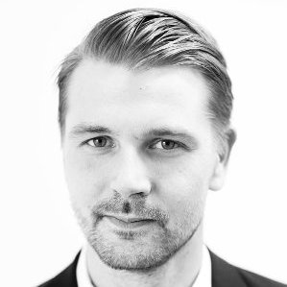
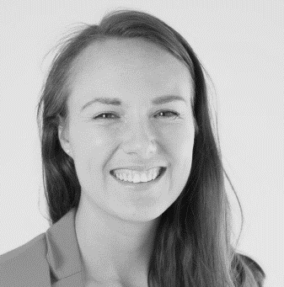
Hello!
Niklas Grönberg
Management Consultant
070-4530022
Niklas.gronberg@ltubusiness.se
Lisa Ek
Management Consultant
0736889652
Lisa.ek@ltubusiness.se

Slide 4












LTU Business has over the last couple of years gained experience in analyzing, establishing and developing testbeds
Mining and raw materials | Data centers | Healthcare | Automotive | Space

Slide 5




We have developed methods to support testbed development - from start to finish
Offer
Customers
Ownership and financing
Establishment

Slide 6


And during these projects we have learned some key factors a testbed need to focus on to succeed

Slide 7
Success factors
What we need to believe in!
Checkout the competition
Too many cooks…
No pain
no gain
Bird in the hand is worth two in the bush

Slide 8

Discover the most critical deal-breakers
Most cases are at their core reliant on the success of a few critical factors
  Before starting project: Identify the factors – scope project around these
  During project: Steer based on factor completion – use as KPIs
  After project: Maintain and identify new long term deal-breakers
What we need to believe in!
You need to deeply understand the what, not the how at the start
  Financial reality: Understand the business case
    What revenue do we need to cover the costs? What amount of customers, pricing level and market share does that imply?
  Business reality: Are you sustainably competitive
    What target customers must be captured? What service level and/or customer value do we need to deliver [time, cost, performance etc.]
    What competences and skills do we need to serve the customers?
    What technical requirements do we need to fulfill?

Slide 9
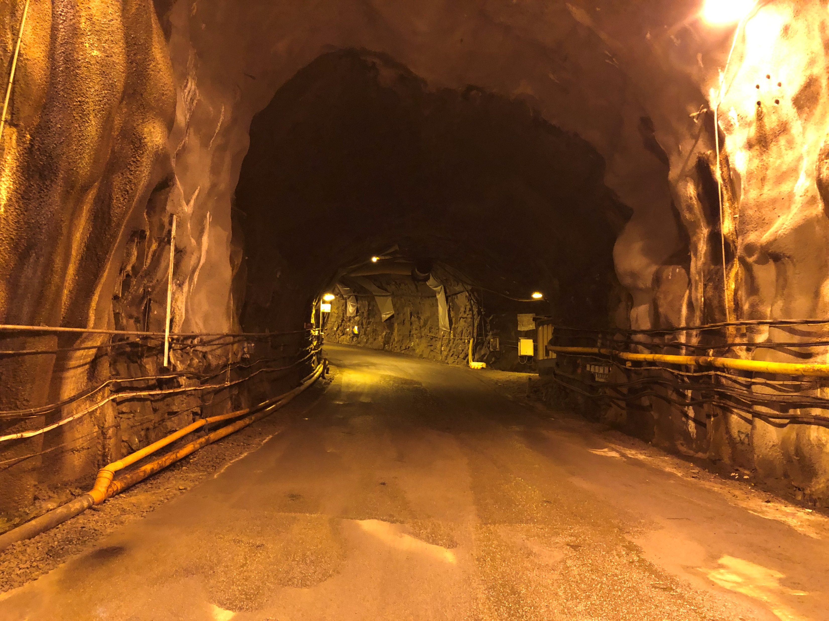
[Sanitized]
Examples: For a geothermal energy test site we need to believe that…
What we need to believe in!
… 60% of our revenue comes from external test needs in Segment A, implying a Nordic market share of 50% - Can we really achieve that?
… Our testbed can facilitate 3 simultaneous tests at the same site – can it be done?
… External research projects are willing to, on average, spend up to 15% of their funding on testbed-costs – Is it reasonable?
… We can cut 20% of customers current testing costs? Is it reasonable?

Slide 10
The basics: you need ’customers’ to survive
Breaking peoples’ habits are hard, how can you make them change? → find their pain points
  Organizations that succeed with identifying pain points are 28 % more likely to close a sale¹
Classic test and demo pain points: waiting time, high costs, low quality, remote locations
So how do you find the pain points? You ask!
  It’s an art form!
  Map different customer segments --< are there new? How can trends and regulations help?
  Existing customers, potential customers, lost customers, your own organization, industry experts
Sometimes you need to ask bluntly – “what are you willing to pay”
  Expression of interest, letters-of-intent etc. are not good enough
No pain, no gain
¹ Salesforce Work.com and The TAS Group report

Slide 11
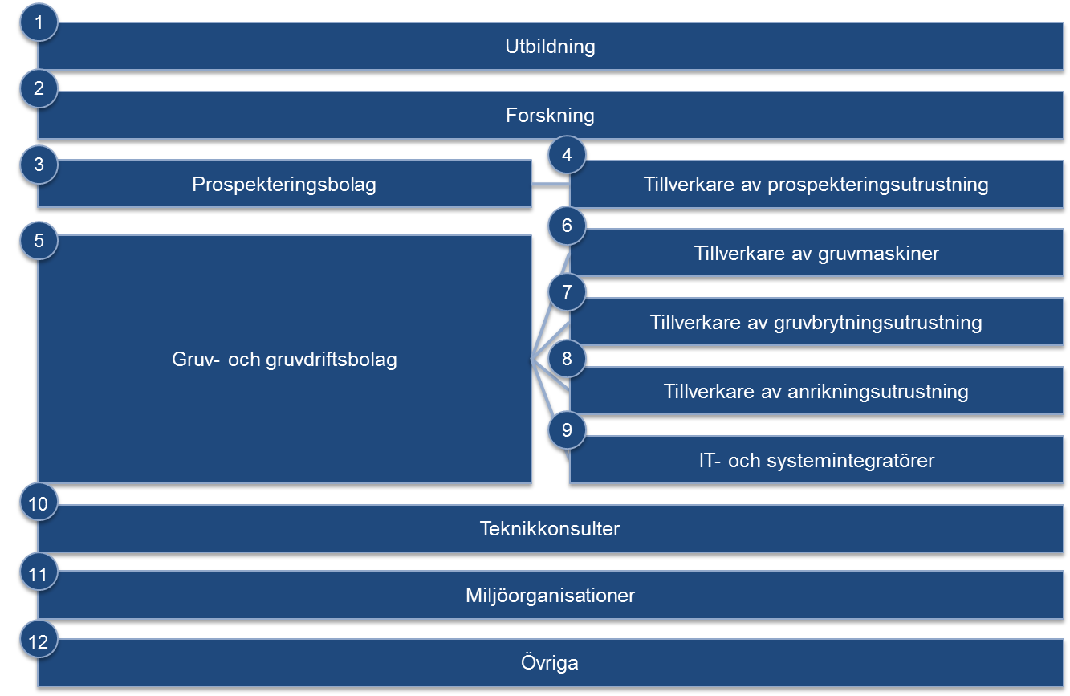
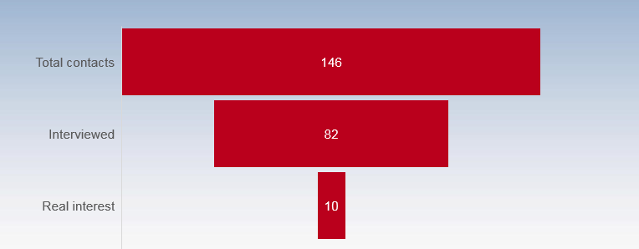
Example: Open pit and mining processing plant
No pain, no gain
Customer segmentation
Interview score sheet

Slide 12

Example: Integrated test organization within mining
No pain, no gain

Slide 13
Understand the competitive landscape and find your position
There is always competition – the trick is to find the sweet spot
  Direct competition, indirect competition and common practice [which sometimes is not conducting any tests at all]
Having a structured process will help in focusing your effort where it really matters
  Understand how the target segments currently solve their needs - what is most important?
  What are the advantages and disadvantages of current solutions?
  Are there any un-met needs that we can serve and/or are there weak points where we could have competitive advantages?
Remember: You don’t have to be best at everything, but you need to be different
Check out the competition

Slide 14

[Sanitized]
Example: The competition of a test site for construction and tunneling
How are construction companies testing new innovations to increase their efficiency?
→ In their own current projects – focusing on method and process
So, are there any areas where external tests are needed?
→ Immature innovations needs to be tested in challenging areas
How is this solved today?
→ Mainly lab-scale tests performed in joint research projects
Can we bridge lab-scale and operational environments with our site?
→ Yes, albeit for small volumes for now, it would be unique in Sweden
Check out the competition

Slide 15
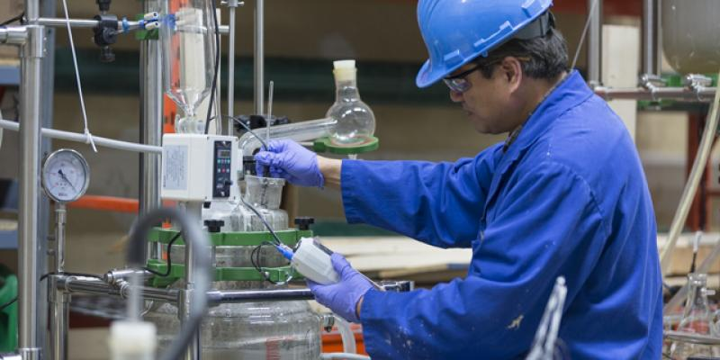
Example: Mineral processing test site
Check out the competition

Slide 16
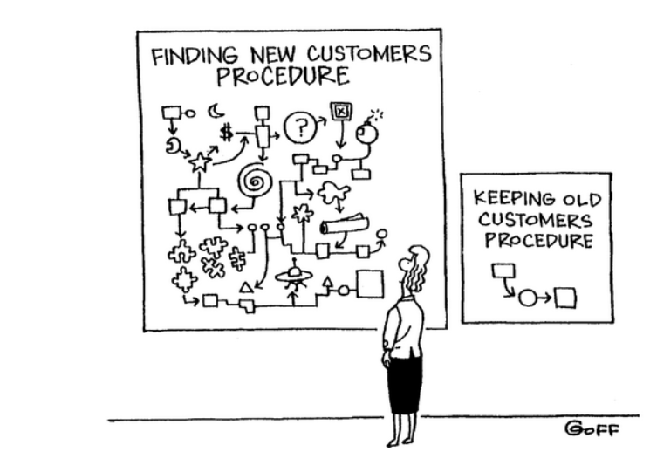
Acquiring a new customer can cost five times more than retaining an existing customer¹ - for a testbed, maybe even more?
The most successful testbed succeed in getting long-term commitments from some key customers/partners
  Most preferably in the form of booked occupancy
Another important way of lowering risk is to diversify the testbed’s income streams
  Research grants, commercial test campaigns, upscaling projects, conferences, events etc.
Bird in the hand is worth two in the bush
¹ Invesp statistics

Slide 17
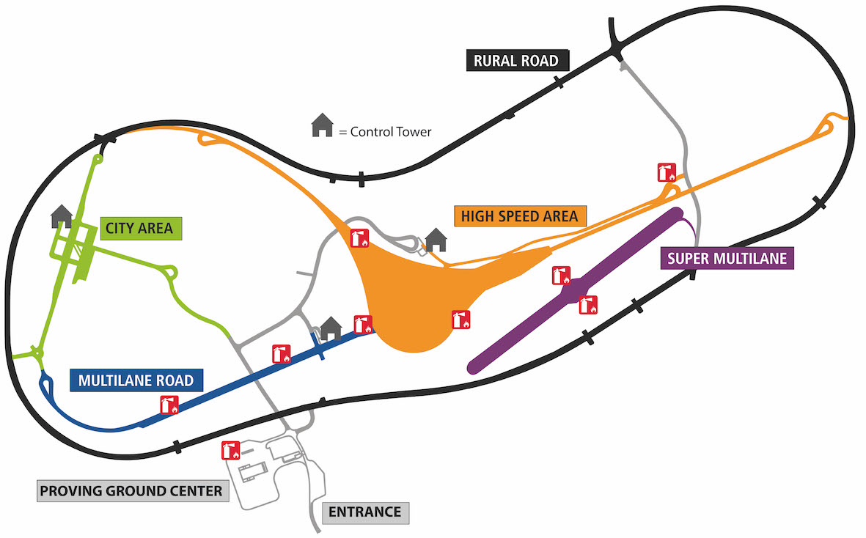
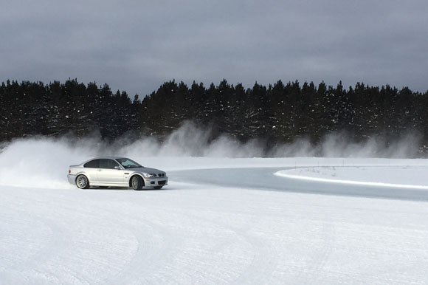

Example: Car and traffic safety test industry
Bird in the hand is worth two in the bush

Slide 18
The long term success needs a strong and aligned foundation
One or a few strong owners with clear synergetic long term ownership-rationales needed
→ Align the ownership strategy as early as possible
Leverage a dedicated management team and clear goals to enable agility and fast reaction time
→ Find the right champions to handle business operations
Business thinking is always needed!
→ Ensure long term strategic view
Too many cooks…

Slide 19

[Sanitized]
Example: The problem of having very fragmented ownership incentives
Too many cooks…

Slide 20
Questions?

Slide 21
Workshop
How can we further develop our Space Testbeds?
Lisa Ek & Niklas Grönberg
LTU Business

Slide 22

The aim of the workshop is to use the success factors in relation to the existing space testbeds and see if we by that can develop them further

Slide 23
You will all be divided into four groups
Testbeds at Space Campus in Kiruna and Luleå
Testbed Esrange
The National Space Data Lab
Students and innovations
Team leader:
Olle Norberg
Team leader:
Philip Pålsson
Team leader:
Ann-Christin Eriksson
Team leader:
Christoper Frisk
and Emil Svanberg

Slide 24


We have three sessions, a coffee break and short presentations in the end
Time
Agenda
Start
09.10
Introduction, assignments and groups
Session 1: No pain, no gain
09.20
Customer segments and their pain points
Coffee break
10:00
Take some coffee and mingle
Session 2: Checkout the competition
10:20
Offerings on the market today and how we can be unique
Session 3: What we need to believe in
10:40
What are the most important deal breakers for your testbeds to succeed?
End-discussion
11:20
Results and discussions with team leaders in full group

Slide 25
Session 1: No pain, no gain
  Topics to discuss:
    Which are the most important/most likely customer segments of your testbed? (who are they, where are they, how many are they)
    What are their most critical needs? What pains are they experiencing?
      What are the three most important factors valued by customers?
    Can your testbed fulfil their needs and help their pains?
  Expected output:
    Customer segment description
    Description of the most important needs and pain points for each segments, and if/how you can fulfill them or what is needed to fulfill them?

Slide 26
Session 2: Checkout the competition
  Topics to discuss:
    How do the customer segments solve their needs today? Which organizations help them?
    How can we be different/unique compared to the competition?
      How do you stack up on the three most important factors valued by customers compared to your competition?
  Expected output:
    List of competitors and their offering
    List of your testbed’s possible unique selling points today and in 3 years time

Slide 27
Session 3: What we need to believe in
  Topics to discuss:
    Financial reality:
      How much income is needed to survive? How many customer cases does that imply?
    Business reality:
      What technical and service possibilities does your testbed have? Which offerings can these possibilities create? When can you deliver these?
      What skill sets are most critical for you to have/to develop?
      How much occupancy can you offer customers? Do you have any bottle necks?
      Do you have any make-or-break customers that needs to be captured?
    If you have the time: what offerings could you create with some investments/recruitments etc.
  Expected output:
    List of the most important factors you need to believe in to succeed
    Brief description of your testbed offering
    Brief description of the financial reality
      If you´re already up and running – are the deal-breakers in 3 years time?

