Slide 1

Testbeds for Space
SPACE
INNOVATION
GROWTH
COOPERATION
Olle Norberg

Slide 2

TESTBED?
What is that?
JOIN US

Slide 3
Testbeds are platforms and environments for experimental testing for research and product development

Slide 4
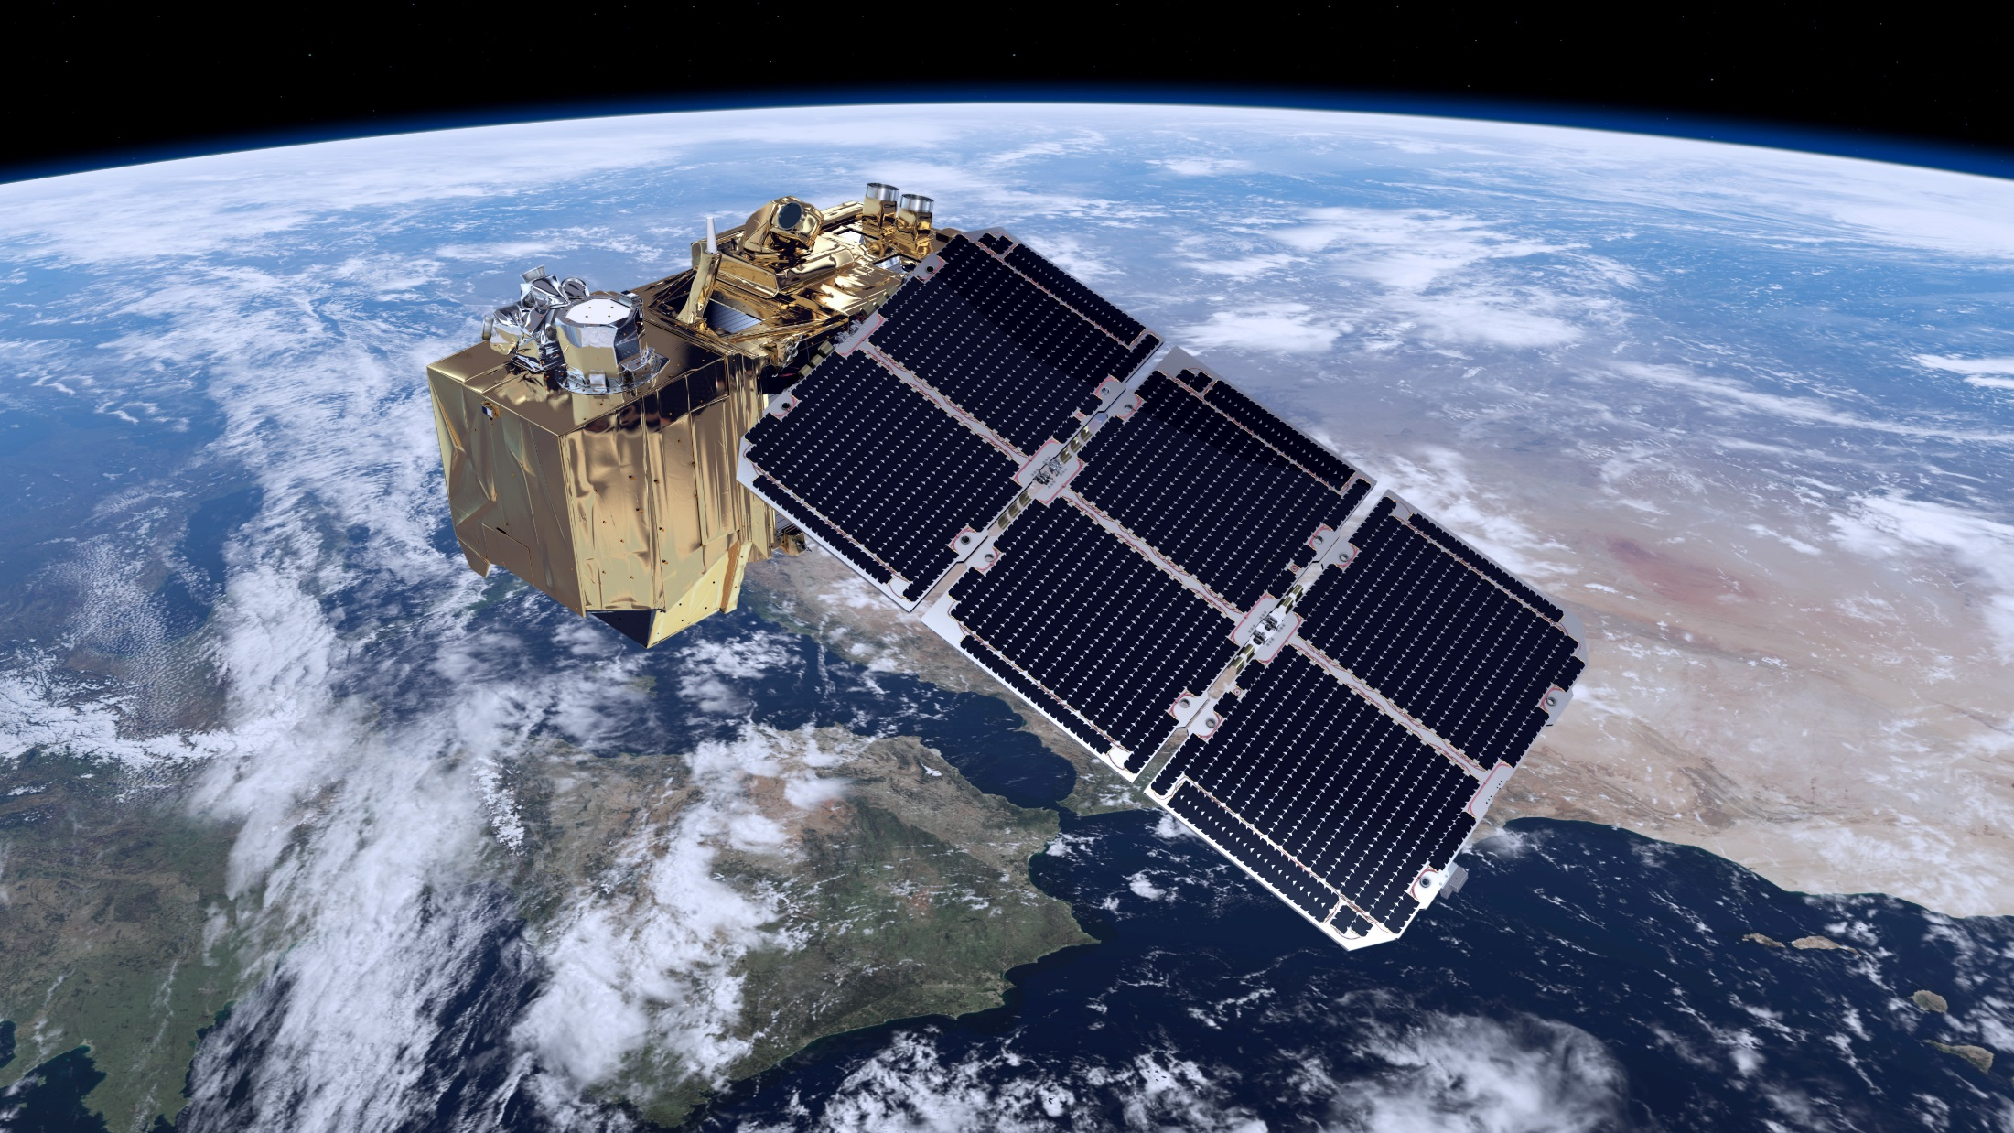

Slide 5
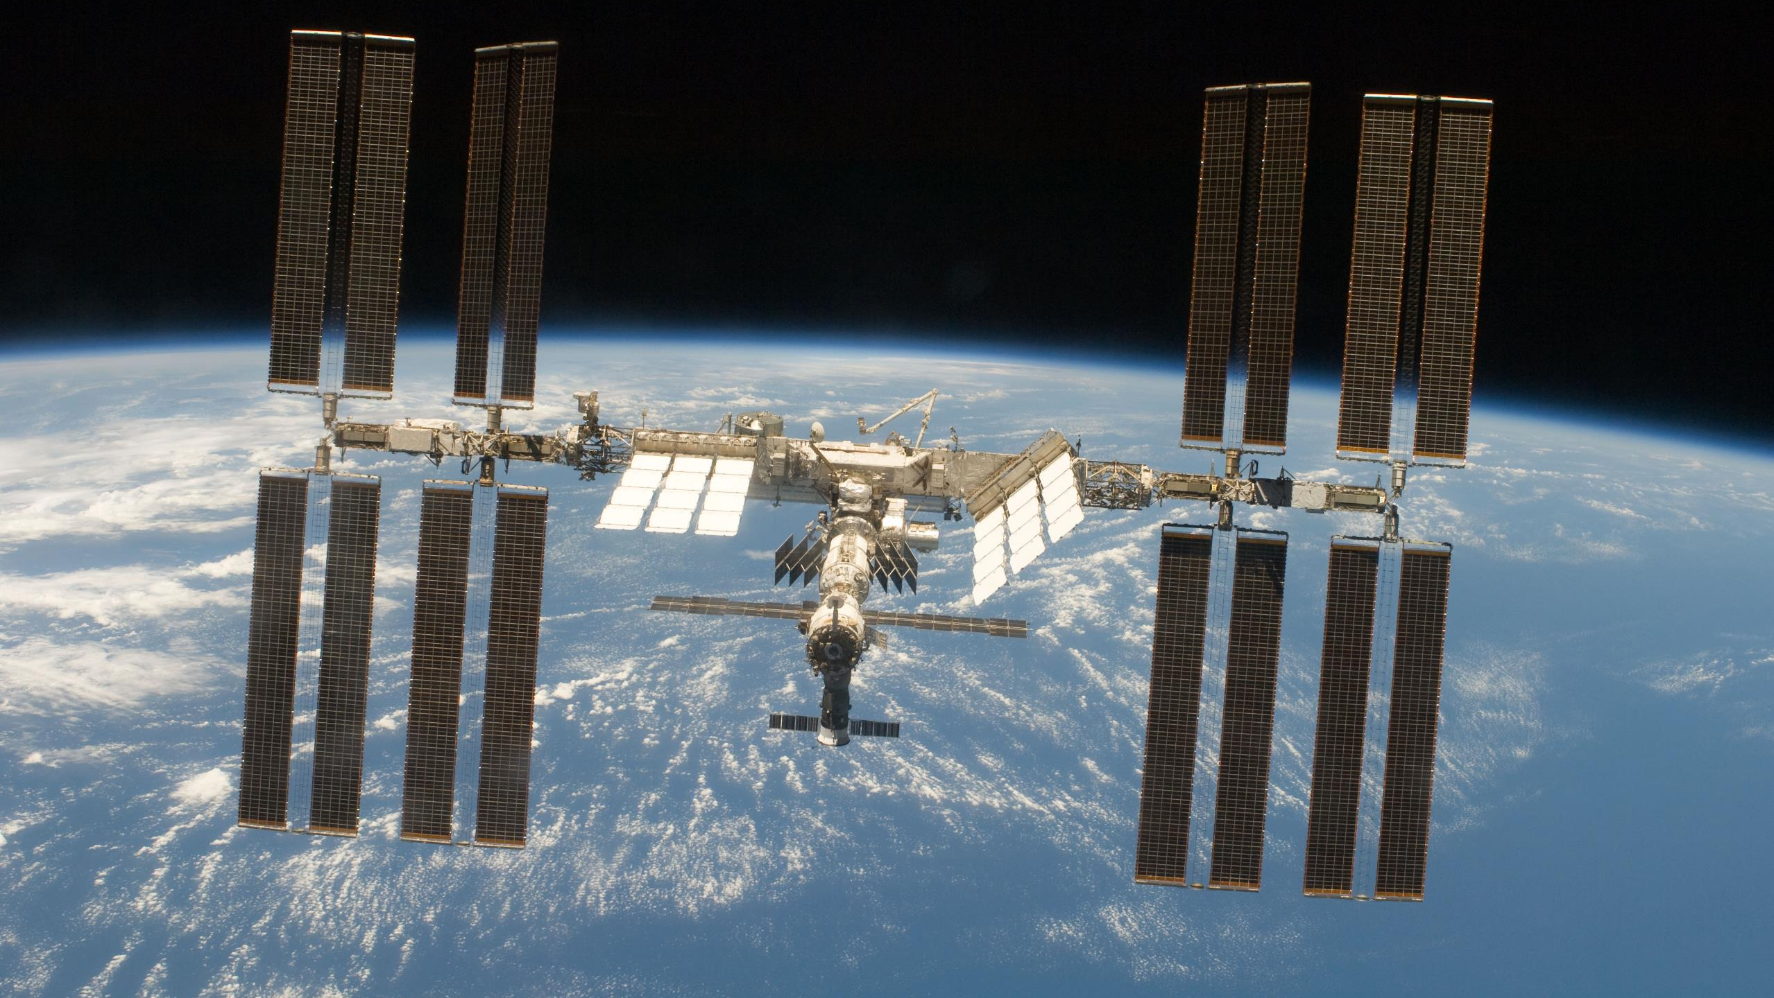
Space Test Domains
Thermal Environment
Mechanical Environment
Radiation Environment
Electromagnetic Compatibility

Slide 6
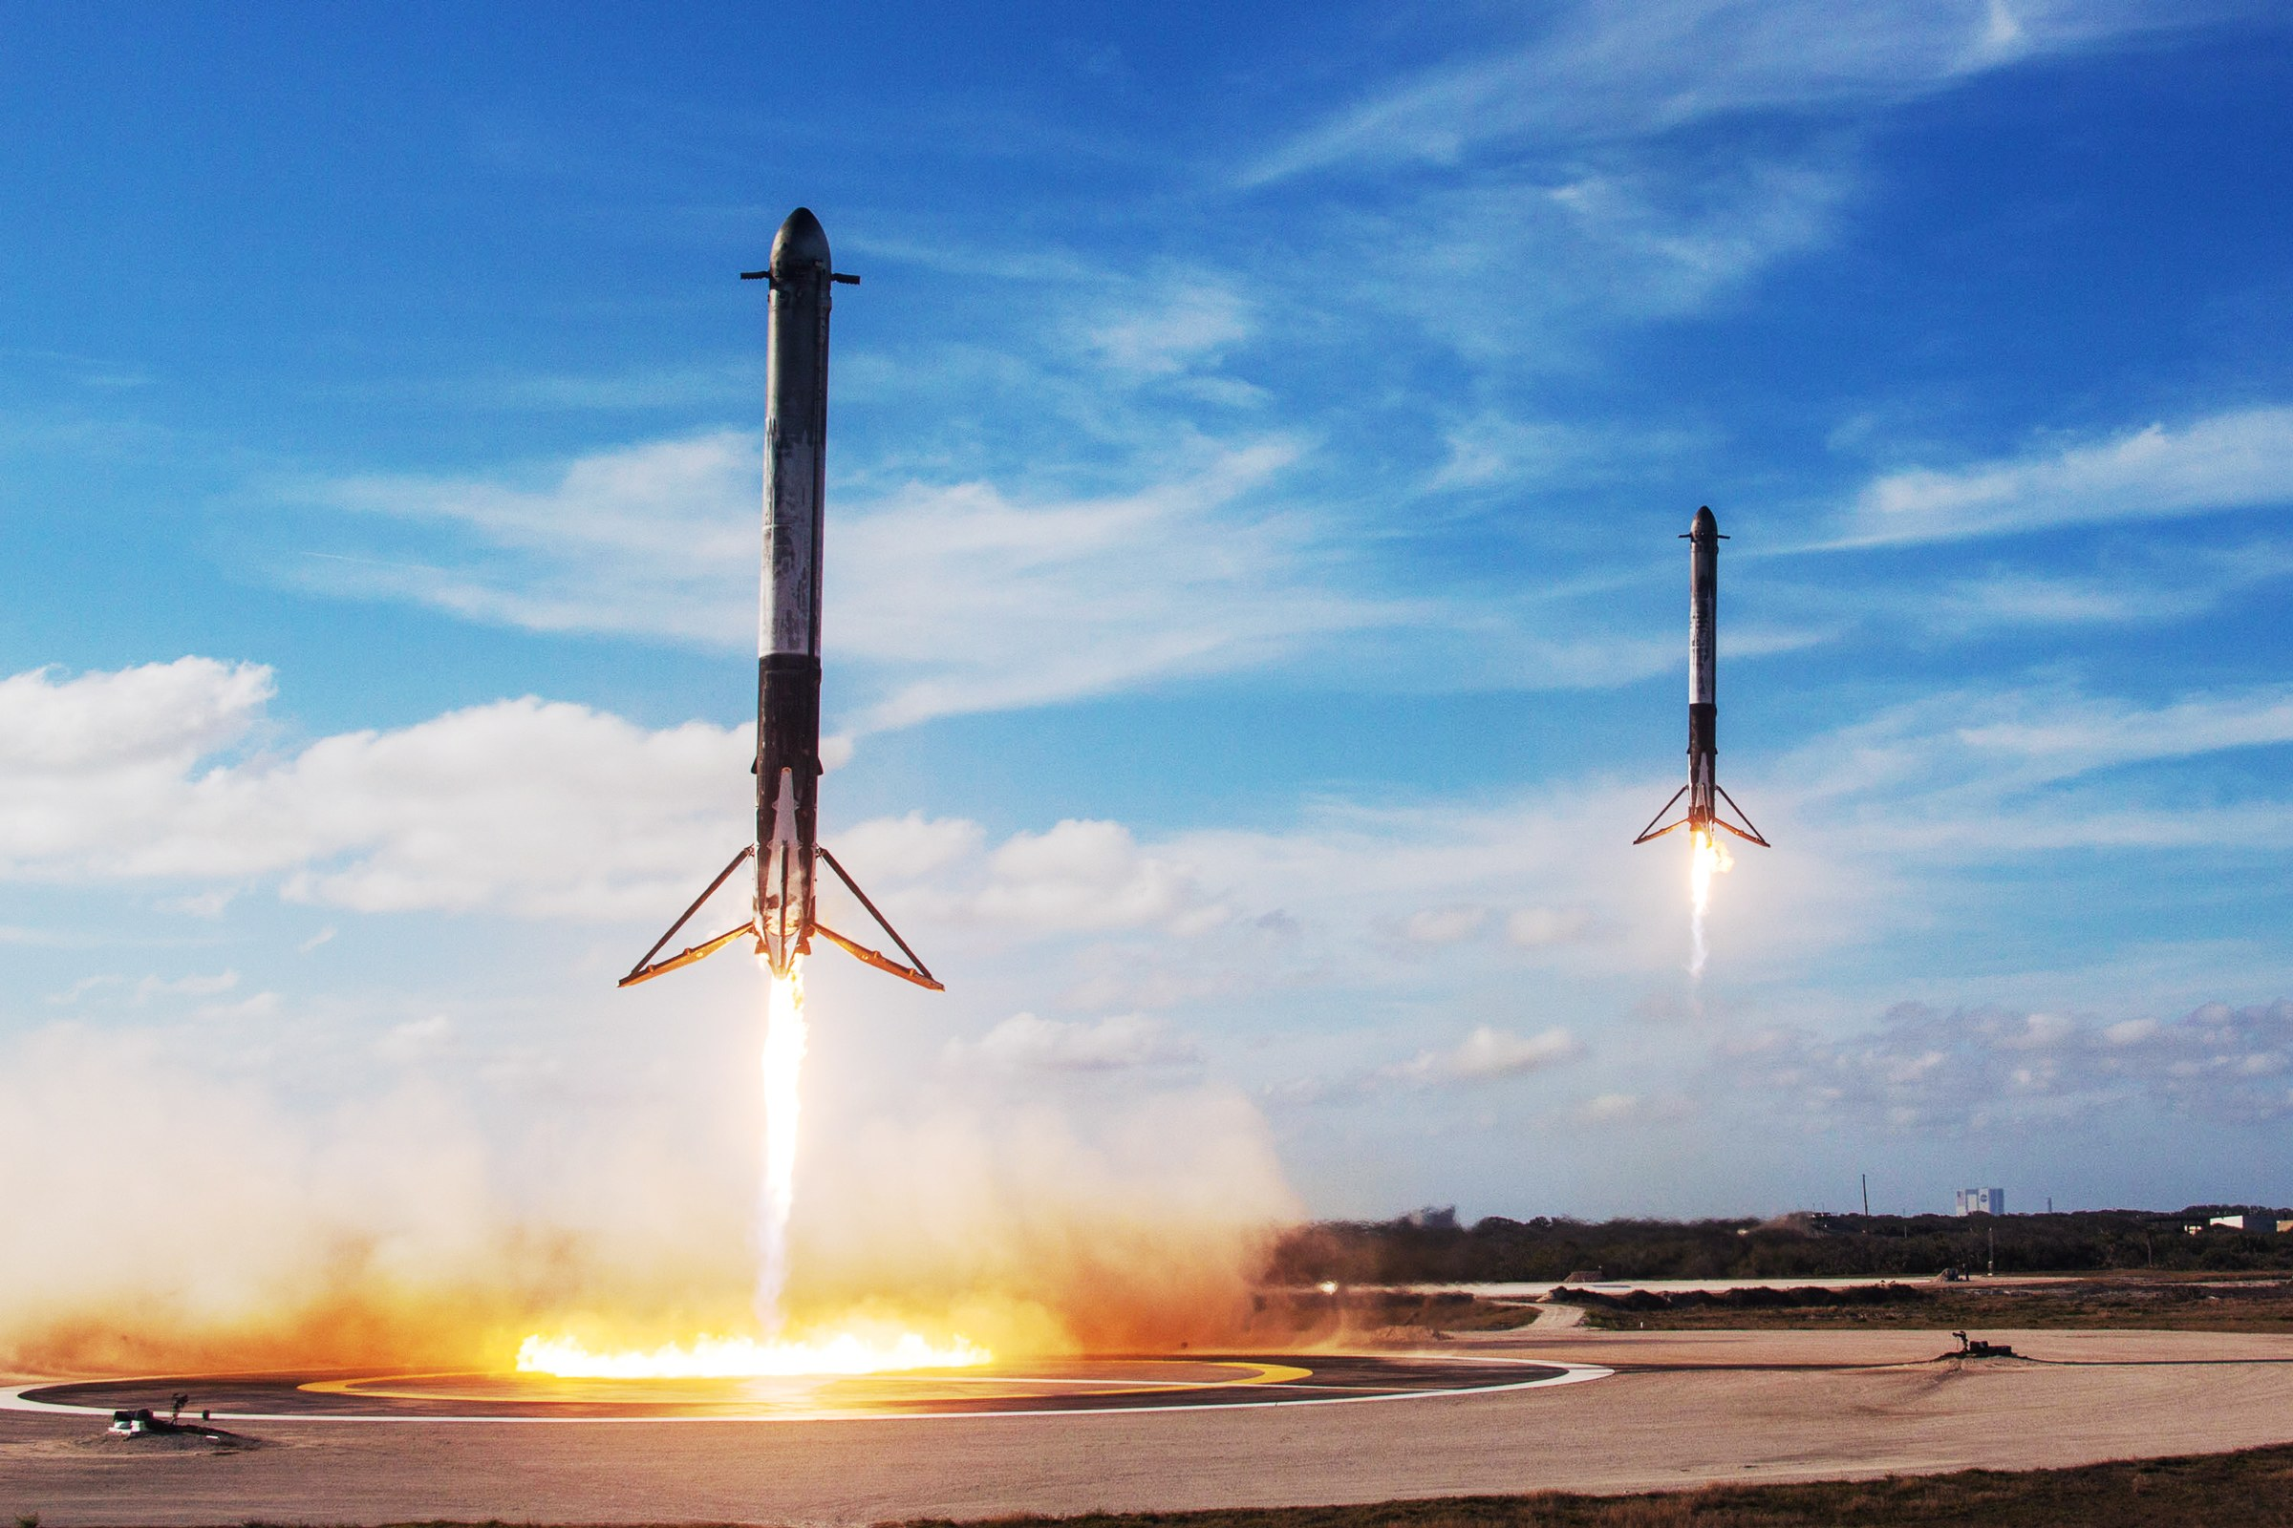
Falcon Heavy Boosters
Launch Vehicle Testing

Slide 7
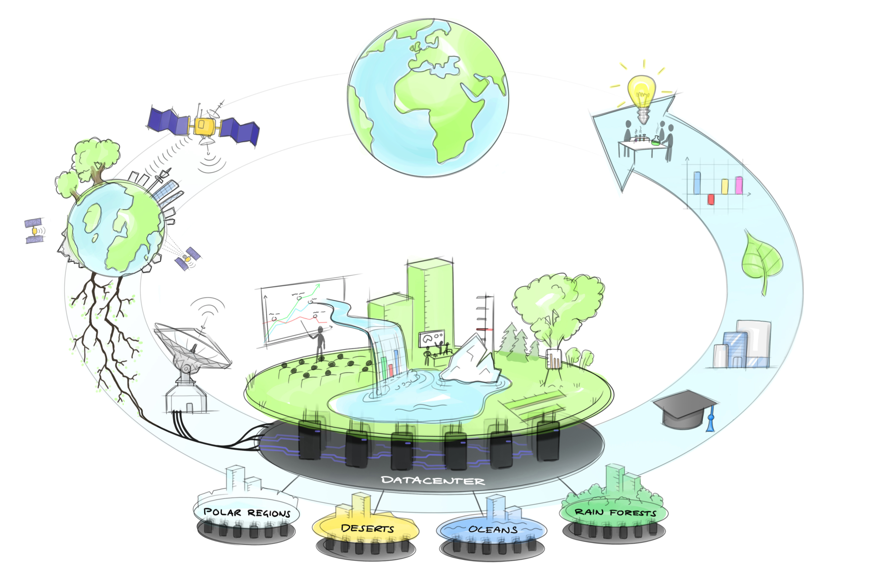
Software Testbeds

Slide 8
THE NEW SPACE ECONOMY
Many new actors, faster development cycles, iterative development – all this means the need for testing of space systems is increasing
– a lot.

Slide 9

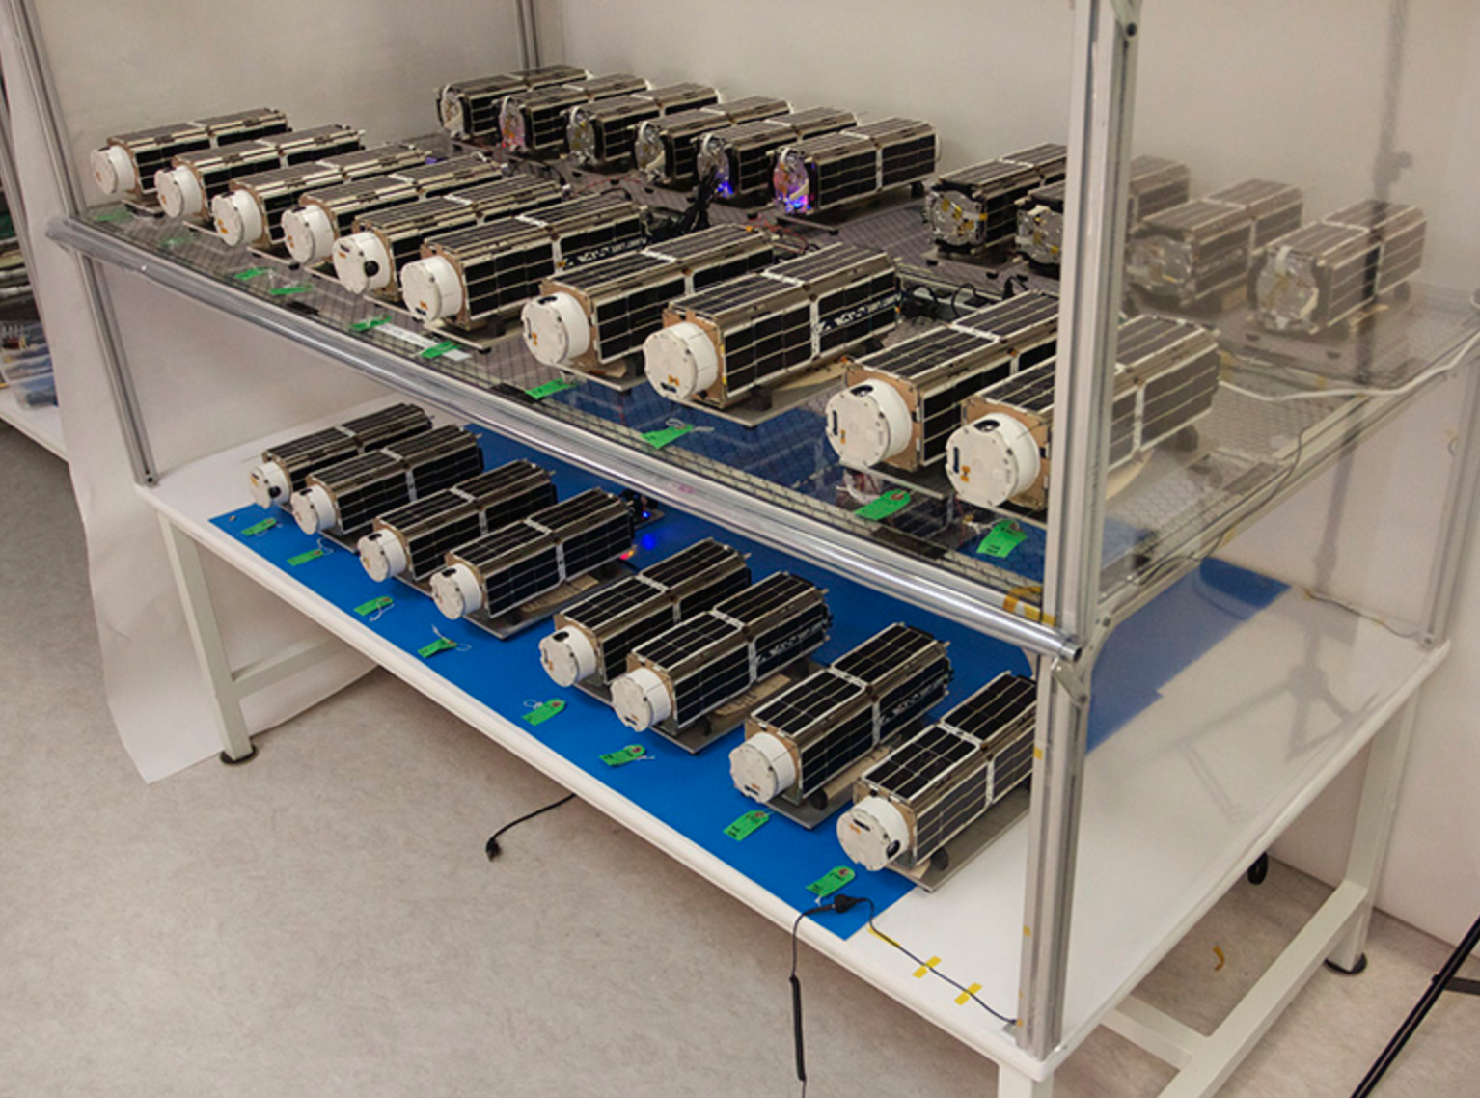
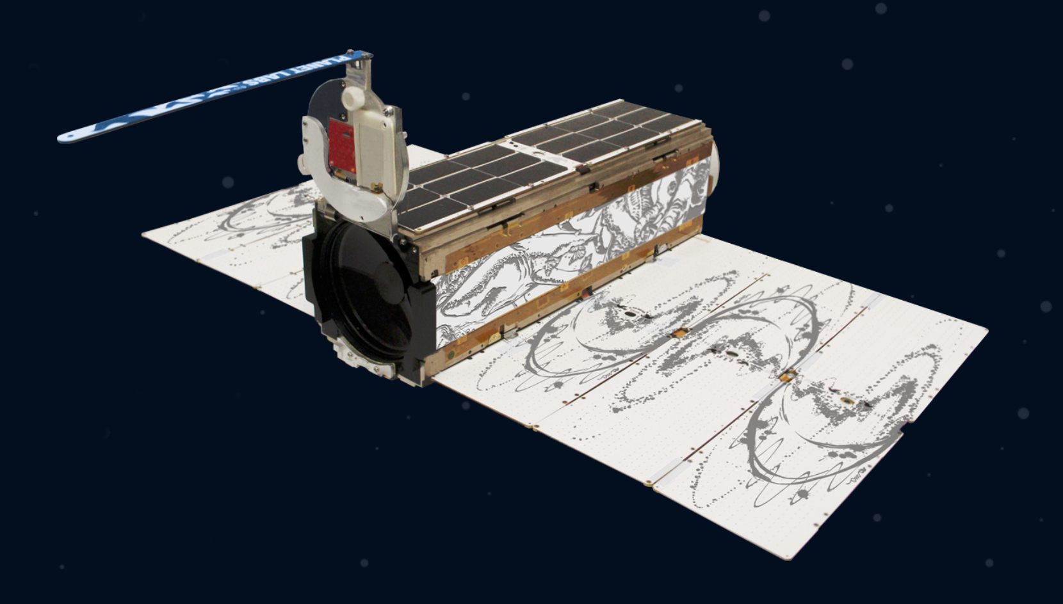

Slide 10
Our goal…
… is to strengthen the Testbeds for Space in Northern Sweden:
Existing and future facilities and competencies at Esrange Space Center, IRF, EISCAT, and LTU
Long term testing experience in Sweden at IRF, OHB, RUAG, GKN, SSC, others
New Space experience of Swedish companies such as GomSpace, ÅAC Microtec/Clyde
Incubation services, ESA-BIC Sweden managed by ABI
And of course including everyone wanting to join in!
Workshop tomorrow at Camp Ripan with four groups /topics:

Slide 11
Topic 1: Testbeds at Space Campus in Kiruna and LTU in Luleå
Resources in Northern Sweden for tests of space hardware and software

Slide 12
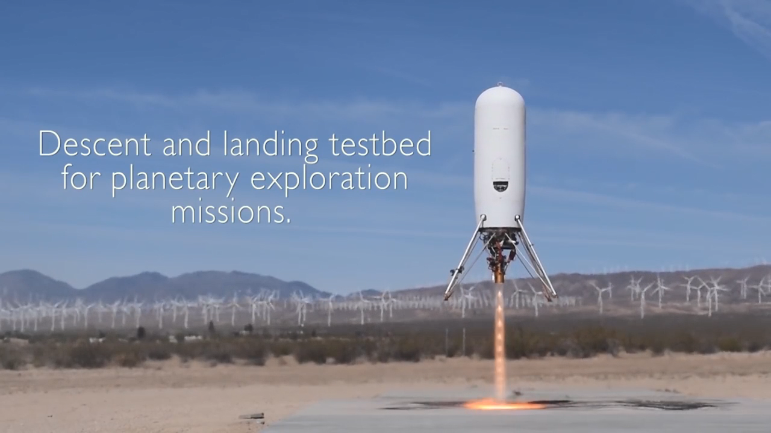
Topic 2: Testbed Esrange
Resources at Esrange Space Center for tests of rockets, stages, motors, reusability, planetary/moon landers, etc.

Slide 13
Topic 3: Space Data Lab
Resources in Sweden to use space data and develop AI solutions for the good of the planet

Slide 14
Topic 4: Students and Innovation

Slide 15
THANK YOU
SPACE
INNOVATION
GROWTH
COOPERATION

